Slide 1
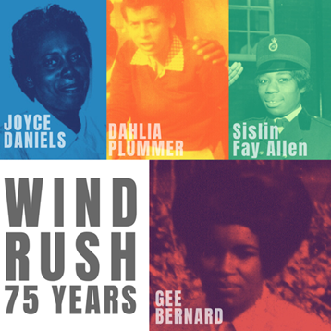


Slide 2
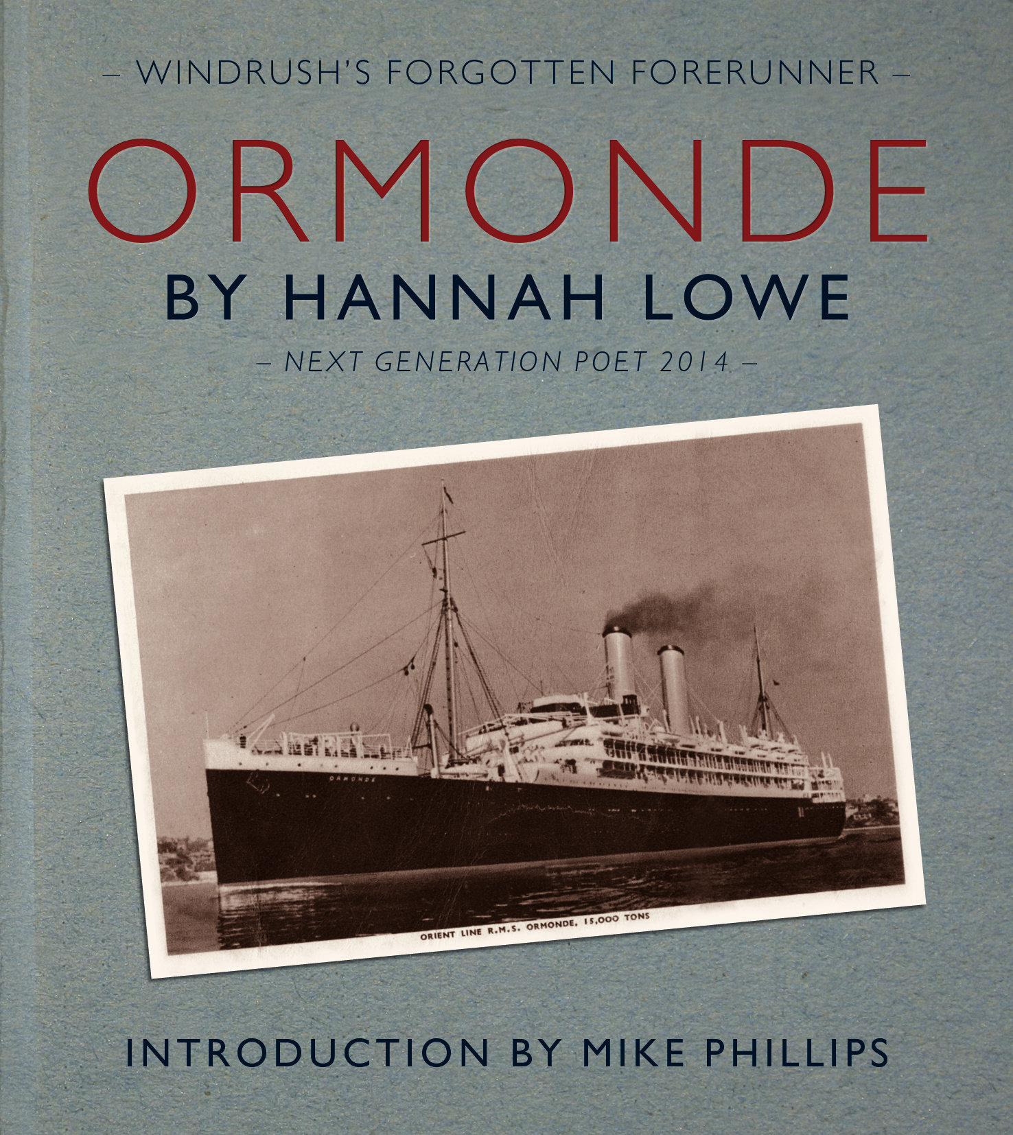
The Windrush Generation refers to lots of people that arrived in Britain from the Caribbean in the Post War Years.
The Empire Windrush was one of many ships that brought people to Britain. Others were the SS Ormonde (March 1947) and the SS Almanzora. (December 1947). People also arrived by plane.
They came because they were invited and encouraged to come to help rebuild Britain after war.

Slide 3
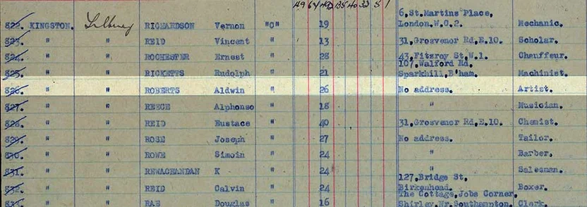
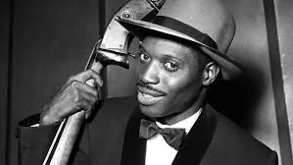

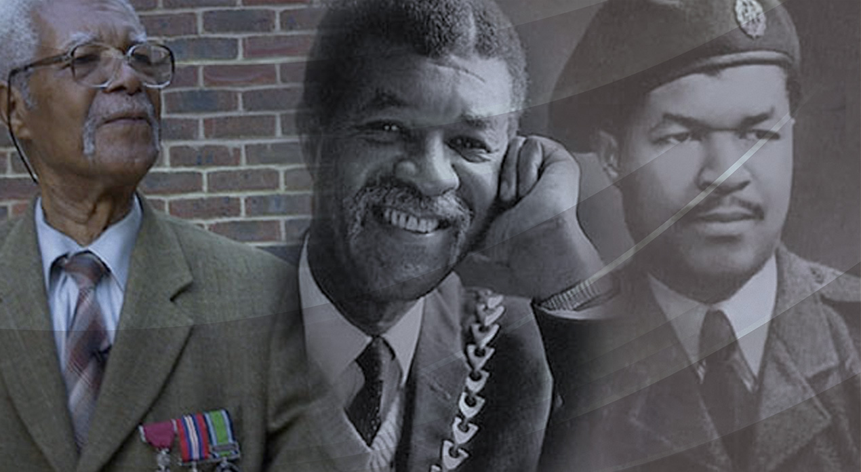
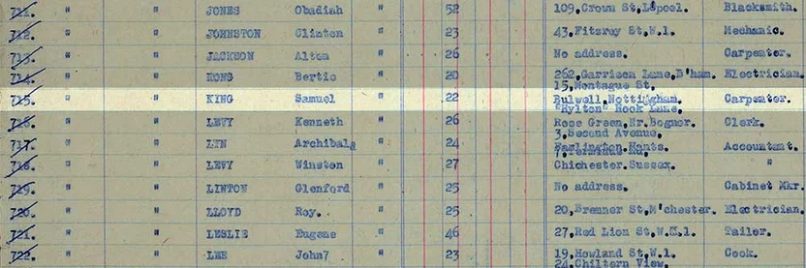

Slide 4
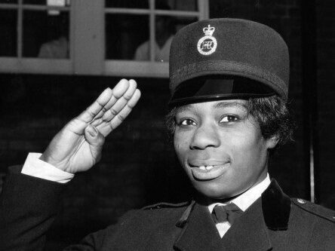
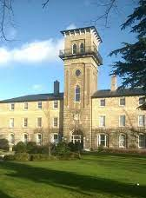
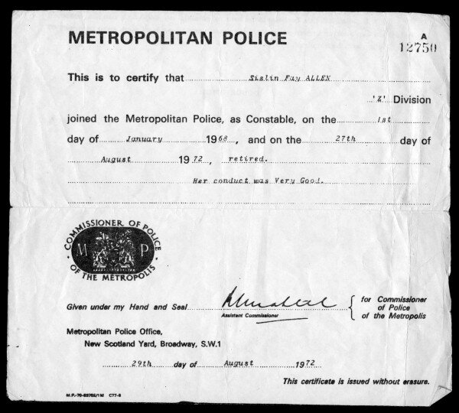
Sislin Fay Allen
Sislin Fay Allen came to England from Jamaica in 1962. She was the first black woman to work for the Metropolitan police.
There were less than 600 policewomen working in Britain by the late 1960s.
Sislin also worked as a nurse at Queens Hospital, Croydon.

Slide 5
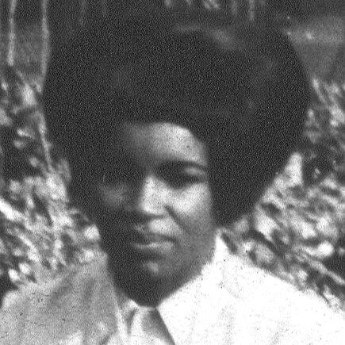

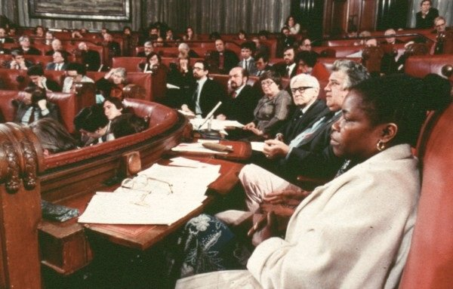
Gee Bernard
Gee started her career in England when she qualified as a social worker while living in Thornton Heath.
Gee Bernard was Croydon’s first black councillor and represented the West Thornton ward from 1986 - 2002

Slide 6
