Slide 1
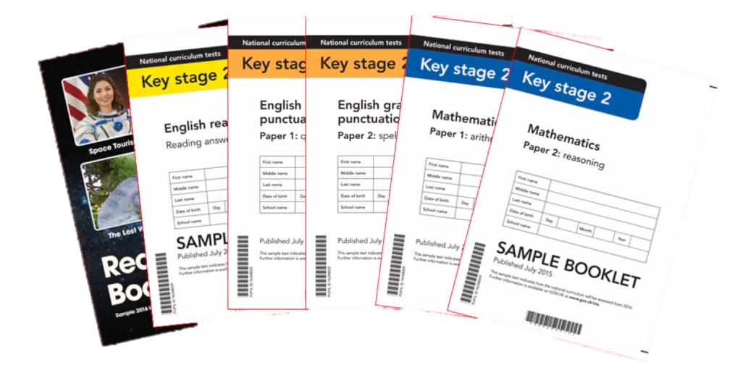
End of KS2 Assessments (SATS)
2024-25
Notes:
Mel

Slide 2
Aims:
We want you to have a better understanding of what your children will be expected to do in the 2025 SATs.
We want you to be aware of:
When the SATs are
How long each paper is
Example questions
How you can support your child
The tests are in place to track children’s progress from Key Stage One, so it’s a great chance to recognise how far they’ve come.
Notes:
Mel

Slide 3
The week commencing 12th May
The timetable for that week is as follows:
Monday 12th May – Grammar Punctuation and Spelling Papers 1 and 2
Tuesday 13th May – Reading Paper
Wednesday 14th May – Maths Arithmetic Paper 1 and Maths Reasoning Paper 2
Thursday 15th May – Maths Reasoning Paper 3
Notes:
Mel

Slide 4
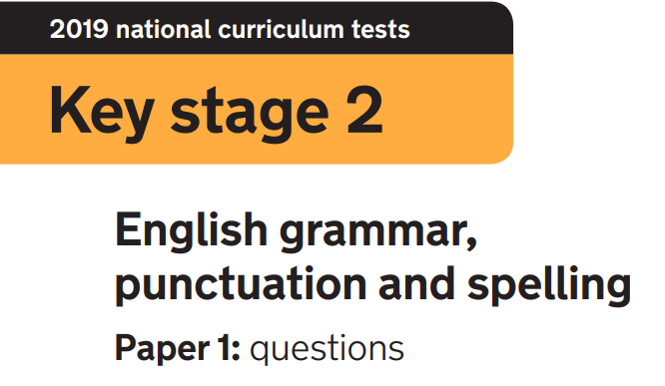

Paper 1: questions
45 minutes
50 questions to be completed
Marked out of 50 as all the questions are worth 1 mark
Paper 2: spelling
No time limit because the spellings and example sentences are read out by the test administrator (usually the class teacher)
20 spellings
Marked out of 20
The results of the grammar paper and spelling test are added
together to give a combined score out of 70.
Notes:
Reena

Slide 5
The grammar paper tests your child’s ability in 7 areas:
Grammatical terms / word classes
Functions of sentences
Combining words, phrases and clauses
Verb forms, tenses and consistency
Punctuation
Vocabulary
Standard English and formality
Notes:
Reena

Slide 6
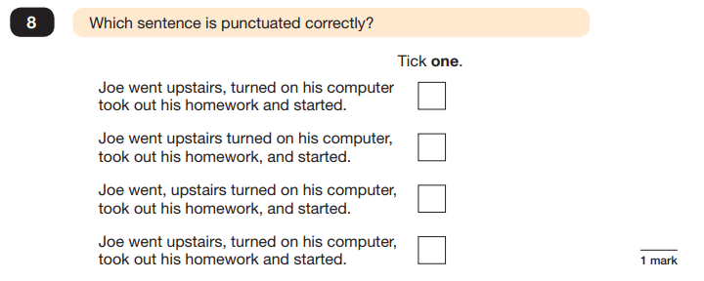
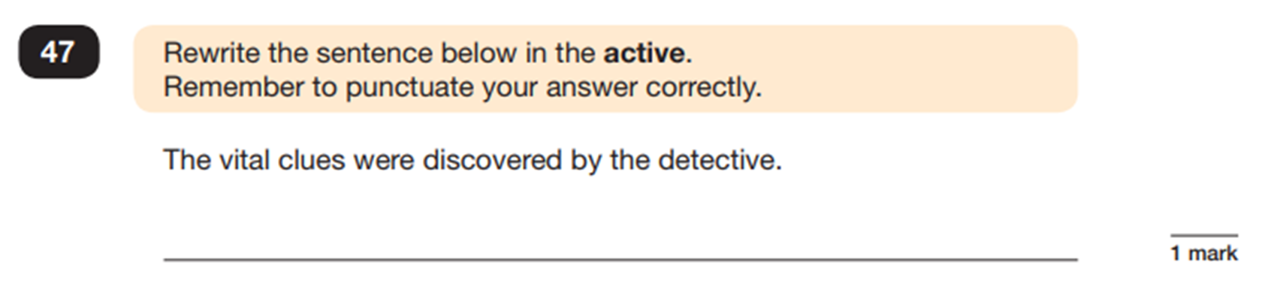
The questions paper is also made up of different types of questions:
Multiple-choice answers
For some questions, you do not need to do any writing. Read the instructions
carefully so that you know how to answer each question.
Short answers Some questions are followed by a line or a box. This shows that you need to write a word, a few words or a sentence.
Notes:
Reena

Slide 7
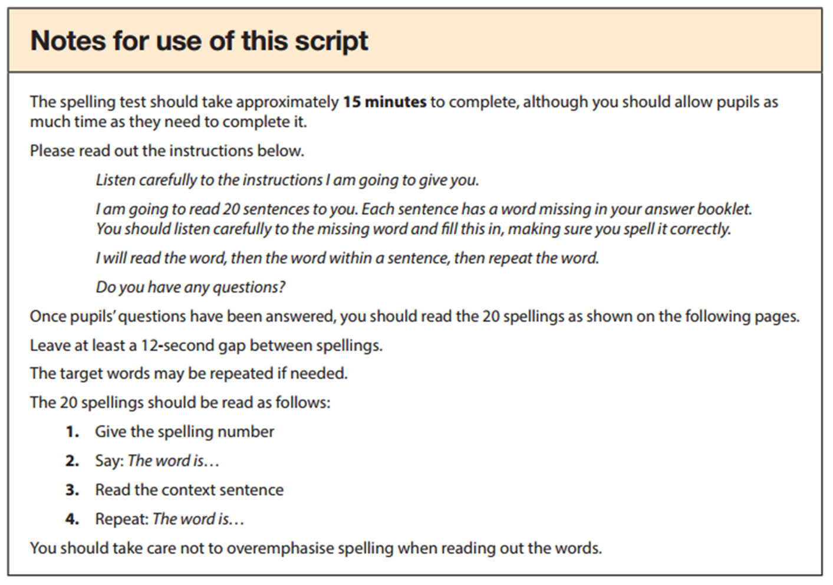
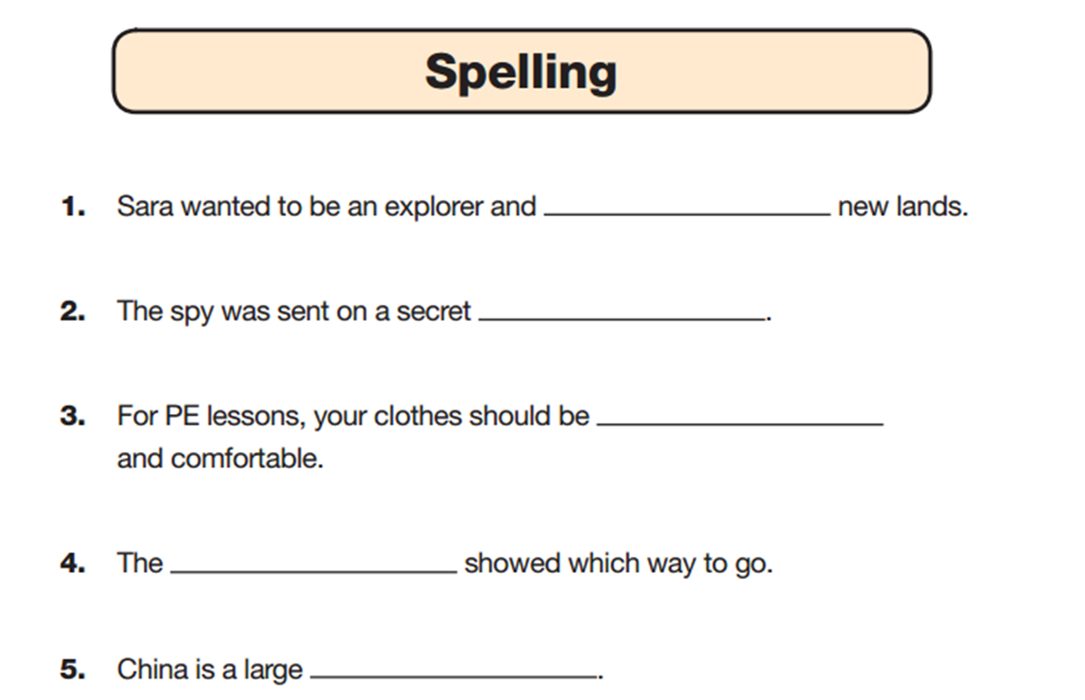
The spelling paper is usually administered by the class teacher.
This is the example script:
This is what the answer booklet looks like:
Notes:
Reena

Slide 8
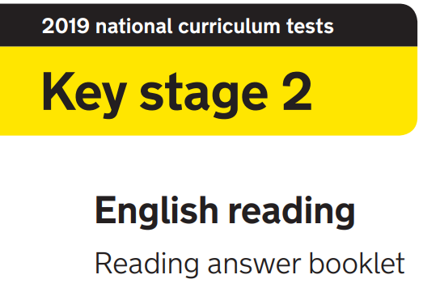
1 hour
The reading booklet consists of 3 texts
The answer booklet usually has 39 / 40 questions to be completed
Marked out of 50 as some questions are worth more than one mark.
Notes:
Mel

Slide 9
The reading paper tests your child’s ability in 8 areas:
Give / explain the meaning of words in context.
Retrieve and record information / identify key details from a text.
Summarise main ideas from more than one paragraph.
Make inferences and explain and justify them with evidence from the text.
Predict what might happen from details implied and stated.
Identify / explain how information or narrative contributes to the meaning of the text as a whole.
Identify / explain how meaning is enhanced through choice of words and phrases.
Make comparisons within the text.
Notes:
Mel

Slide 10
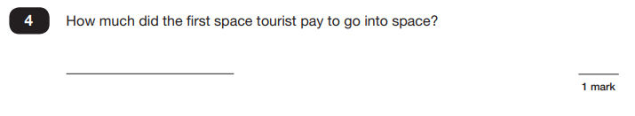
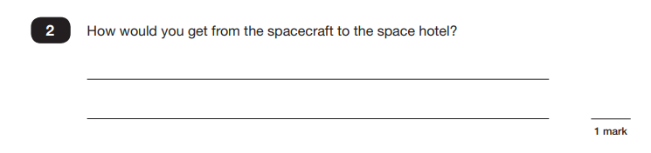
The reading paper consists of a variety of question types:
Short answers
Some questions are followed by a short line or box.
Several line answers
Some questions are followed by a few lines. This gives you space to write more words or a sentence or two.
Notes:
Mel

Slide 11
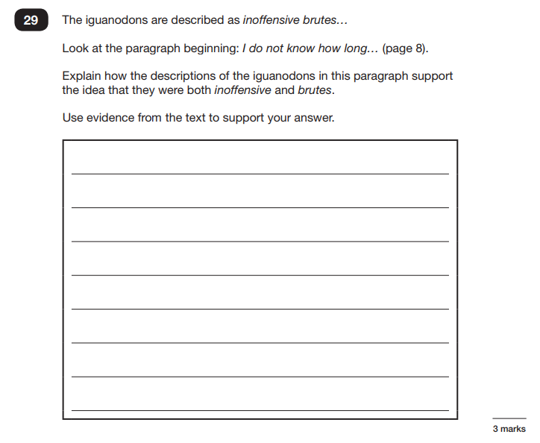
Longer answers
Some questions are followed by more answer lines. This shows that a longer, more detailed answer is needed to explain your opinion.
In previous years, the paper was most heavily weighted towards testing the children’s inference skills, often using questions that require longer more detailed answers that are worth 3 points.
Notes:
Mel

Slide 12
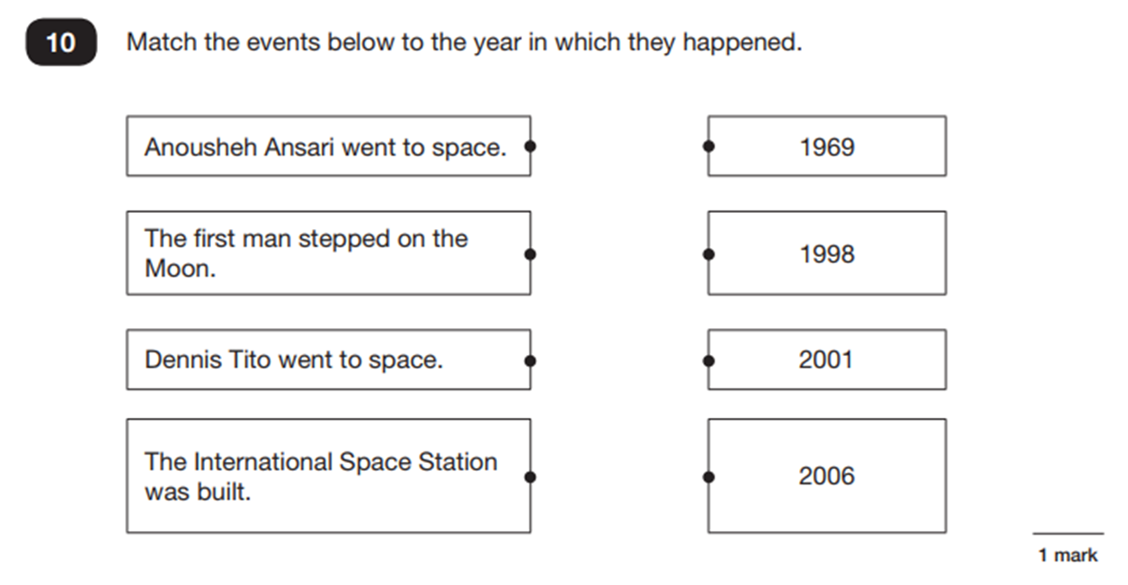
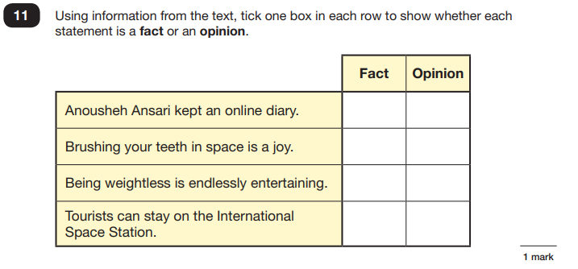
Selected answers
For some questions you do not need to write anything at all and you should tick, draw lines to, or circle your answer. Read the instructions carefully so that you know how to answer the question.
Notes:
Mel

Slide 13
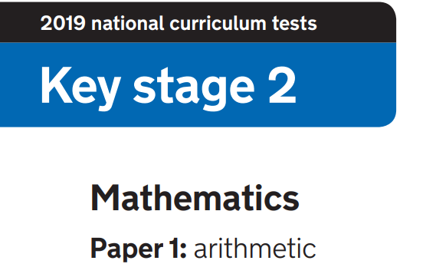
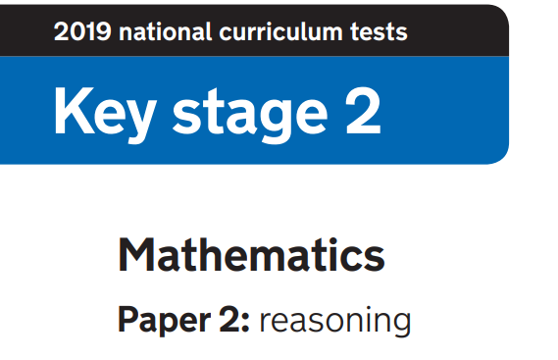
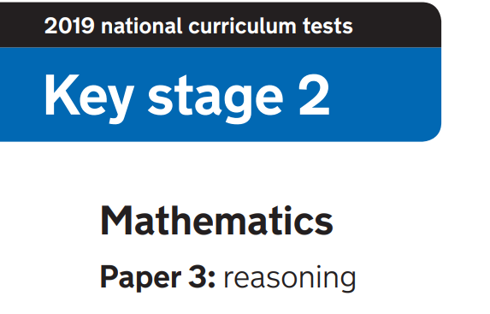
Paper 1: arithmetic
30 minutes
36 questions to be completed
Marked out of 40 as the long division and long multiplication questions are worth 2 marks
Papers 2 and 3: reasoning
40 minutes each
Number of questions vary as does the
number of marks given for each answer
Both papers are marked out of 35
The results of the arithmetic paper and the 2 reasoning papers
are added together to give a combined score out of 110.
Notes:
Reena

Slide 14
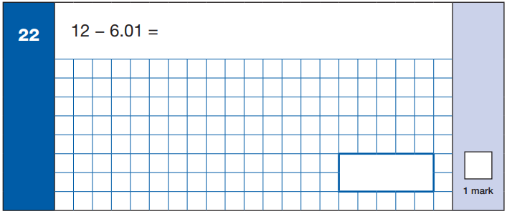
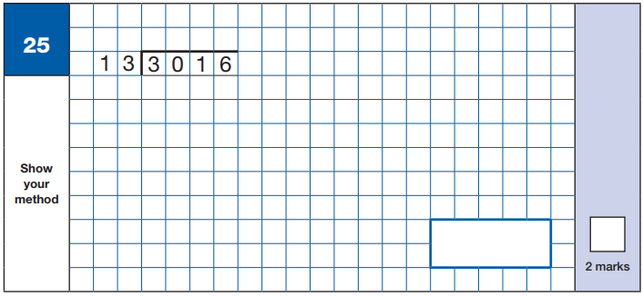
The arithmetic paper is about pure mathematics using written and mental strategies.
By demonstrating use of the correct method, a mark can be gained from the questions worth 2 marks (even if the child has got the actual answer wrong).
Notes:
Reena

Slide 15
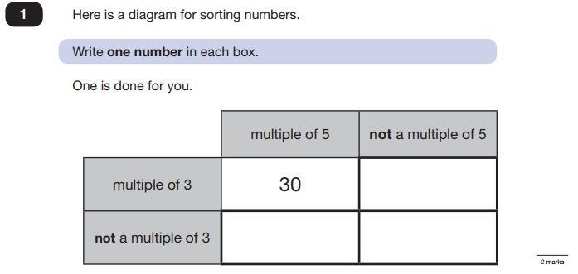
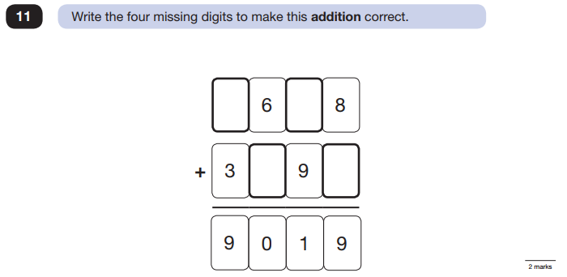
The 2 maths reasoning papers test the children’s ability to use their mathematical skills to solve problems. The children need to interpret what mathematical knowledge or processes are being presented in the question.
Notes:
Reena

Slide 16
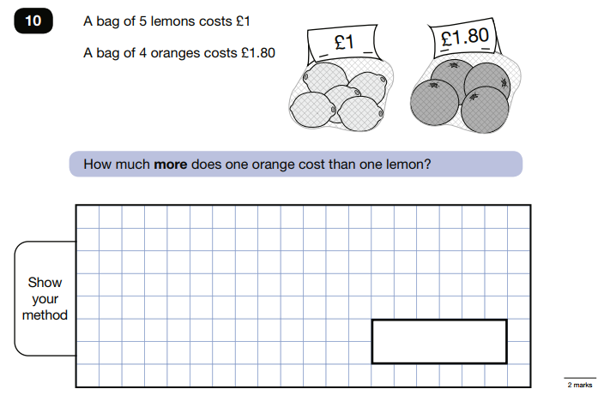
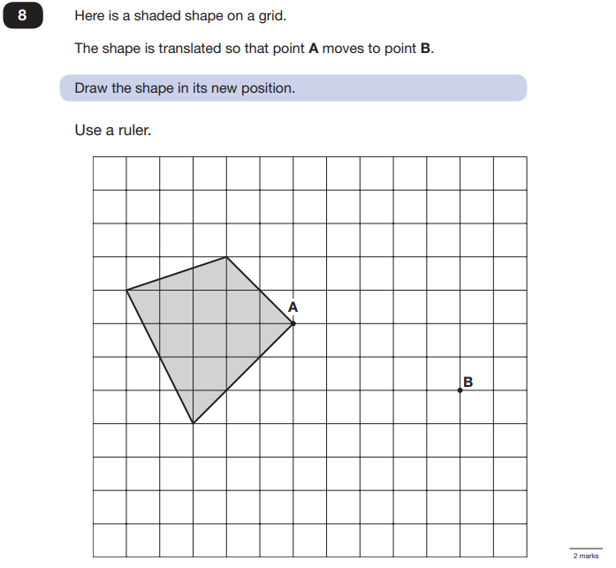
Some of the questions involve reasoning with word problems.
Some of the questions involve using their understanding of geometry.
Notes:
Reena

Slide 17
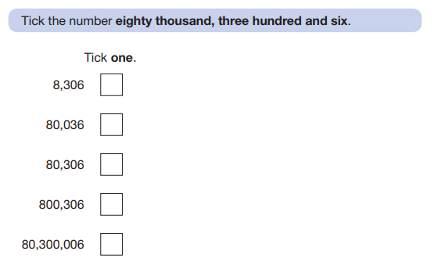
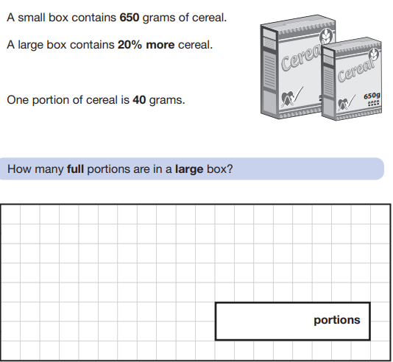
Remember, they are end of Key Stage Two tests, not Year Six tests.
So some are simpler (year 3/4 level)…
…some are more tricky!
Notes:
Reena

Slide 18




How to help your child
Make sure your child reads every day and ask them about what they are reading. It’s still a good idea to read to your child as well, in whatever language you speak at home.
Practise the spelling rules taught at school. You can sign in to Spelling Shed to do this.
Encourage your child to become fluent at their times tables – they can use Times Tables Rockstars to practise. Their login is in their homework diary.
Ensure your child completes their Mathletics or Atom Learning homework every week.
Encourage using maths in every day life too. For example - calculating change, % reduction of items on sale, cooking (and scaling recipes up or down), playing games like Monopoly.
Notes:
Mel

Slide 19




How to help your child
Ensure that your child sleeps 10 hours a night.
Try to make sure they eat healthy meals and drink enough water.
There is a school breakfast each morning of the test week. Please bring your child in for that from 8.15am (individual schools to confirm times).
If your child is unwell on the day of the test, please call the school as soon as possible to decide together what to do.
Please remember - the SATs represent a moment in time; they do not define your child! If their ambition is to be a world class rocket scientist, the SATs result is not necessarily a barrier to that.
Notes:
Mel

Slide 20
How to help your child
Make a note of the dates of SATs week (week beginning Monday 12th May) It is important that your child is at school every day. Please don’t book any routine medical appointments for your child during SATs week.
If your child misses school, they do still have to sit the tests on their return. They will be kept away from their peers until they have sat the tests - not allowed out to play with them or have lunch with them – it’s not enjoyable and a little bit lonely. It’s much better to sit the tests with all your friends and feel as though you are going through it together. So, unless they are really unwell, consider Calpol and a good night’s sleep.
Notes:
Mel

Slide 21
Mathletics
https://login.mathletics.com/#/student
Times Tables Rockstars
https://play.ttrockstars.com/auth/school/student/18726
Oak Academy: A website created by teachers during lockdown with full lessons. https://classroom.thenational.academy/subjects-by-key-stage/key-stage-2/subjects/maths
IXL: offers a limited free amount of questions per day. It also shows you a complete coverage of the Year 6 Maths curriculum https://uk.ixl.com/maths/year-6
Rollama: A website to help with SPaG with fun games for each topic of the SPaG paper. https://www.rollama.com/docs/Rollama_SATs_Paper_1_Map.pdf
Education Quizzes: Both Maths and English based quizzes which are marked as you go along. http://www.educationquizzes.com/ks2/maths/
Online maths tutor: A site with links to old style Key Stage 2 Maths Papers, Maths Tutorials as well as Maths Games.http://www.online-maths-tutor.com/
Sheppard software: Lots of Maths games on a range of Mathematical concepts. https://www.sheppardsoftware.com/math.htm
ICT teachers: A site with a range of information and questions – great for revision purposes!
http://www.icteachers.co.uk/children/children_sats.htm
BBC Bitesize: Fun games and lessons https://www.bbc.co.uk/bitesize/subjects/z826n39
Notes:
Reena

Slide 22



