Slide 1

Secondary
School
Application Process
for pupils starting in September 2024

Slide 2
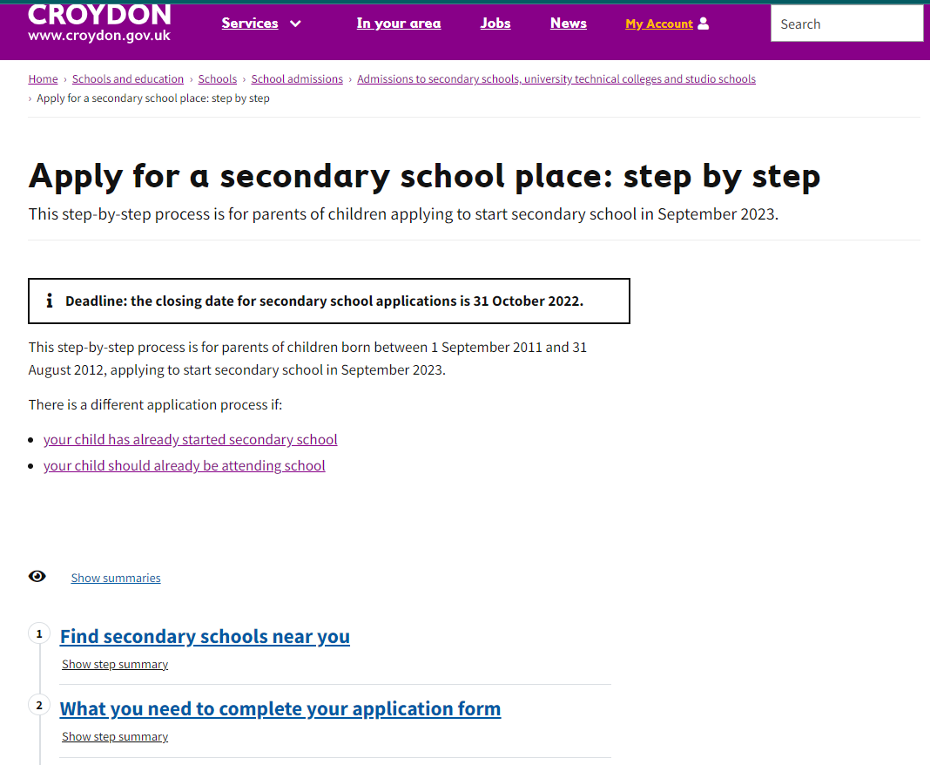
Open days/evenings document can be found at the link below as well as on the Pegasus Academy Trust website.
https://www.croydon.gov.uk/schools-and-education/schools/school-admissions/admissions-secondary-schools-university-technical-colleges-and-studio-schools/step-by-step/apply-secondary-school

Slide 3
Key points:
Information:
www.croydon.gov.uk/admissions
No paper admissions
Deadline 31st October 2023

Slide 4
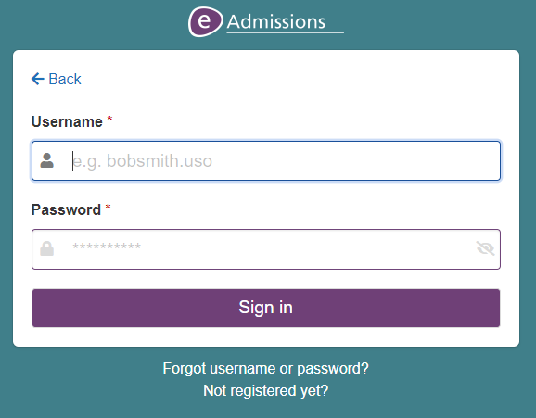
How to apply
Go online to www.eadmissions.org.uk
Set up your account with a registered email address (e.g. googlemail) – You may already have an account for when you applied for your child’s primary place in which case use the ‘Returning Visitors’ button.
Make sure that you make a note of your username and password – you will need this to get your offer of a place.
If you cannot remember your
login and password, click on
‘Forgot username or
password?’

Slide 5
How to apply
Log in
Complete the form
  You have 6 options of school and you can order them according to your preference.
  You can go in and out of the form and change your mind as many times as you want as long as you press submit by the 31st October 2023.
Check for the confirmation email.
You will be sent a confirmation code that looks like this:
306-2022-09-E-000731 Version 1.
The version number will change each time you resubmit if you make changes.

Slide 6
Things to consider
Visit each school’s website – many have virtual tours
Visit the schools during open days/evenings
Read the criteria for each individual school
The borough recommends using all six preferences
Check the number of applications per school
Work out the distance to your house
Complete the supplementary form (if needed) and send it to the school/upload it.
Schools in other boroughs all go on the same CAF (common application form).
Most independent or private schools are not on this form – check their application process by checking their website directly

Slide 7
Admission criteria:
They vary according to school so check.
Statement of SEN or EHCP (where school is named)
LAC (looked after children)
Medical
Proximity to the school (CHECK - it changes)
Religious affiliation
Siblings
Tests

Slide 8
Information needed for your form:
Cypress School | Ecclesbourne School | Whitehorse Manor Junior School
Postcode: SE25 4AU DFE number: 306/2114 | Postcode: CR7 7FA DFE number: 306/3419 | Postcode: CR7 8SB DFE number: 306/2047

Slide 9
Useful phone numbers:
School admissions: 020 8726 6400 + ext 61884
(Monday to Friday 9am-5pm)
Interpreters are available on this number
Eadmissions helpline: 020 8255 5555 + ext 1

Slide 10
Offer day-
1st March 2024 – email and text.
You must accept or decline your offer by 15 March 2024.
To respond to your offer you will need to log into your eAdmissions account – so keep your login information safe.
REMEMBER TO SUBMIT YOUR FORM

Slide 11
If you have any queries or problems with the application process, please contact your child’s class teacher as soon as possible.
You are invited to attend an applications workshop at your child’s school if you have any difficulties, on Wednesday 18th October
GOOD LUCK
AND
REMEMBER TO SUBMIT YOUR FORM

