Slide 1

Pegasus School Journey 2024-25
Jamil Francis
Cuffley
Notes:
Record Meeting!

Slide 2
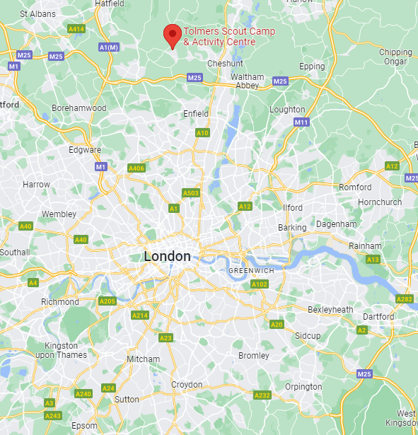
Location
Situated in woodland, roughly 1 ½ hours from Thornton Heath, Cuffley offers a range out outdoor activities such as climbing walls, high ropes and archery
Children will be camping, whilst there is a dedicated refectory & meal stations.
Notes:
We want the children to have lasting memories, have experiences that are not available in inner-city London

Slide 3
Key Information
3 days, 2 nights: Wednesday 4th June, 9:00am– Friday 6th June, 4:00pm (incorrect date on July letter)
Sleeping in tents
Outdoor, wilderness activities and experiences
Coaches to and from the site
Some camping gear required
All food provided
Male and female staff members from each school will attend & supervise
Encouraging as many families to send their children as possible.
Notes:
We want the children to have lasting memories, have experiences that are not available in inner-city London

Slide 4
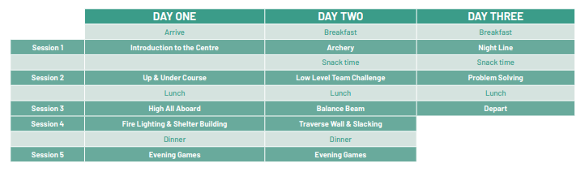
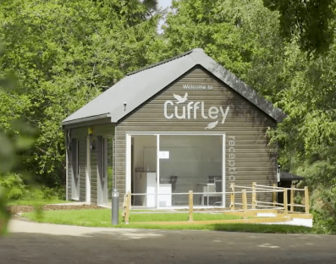
Activities
Link:
Notes:
We want the children to have lasting memories, have experiences that are not available in inner-city London

Slide 5
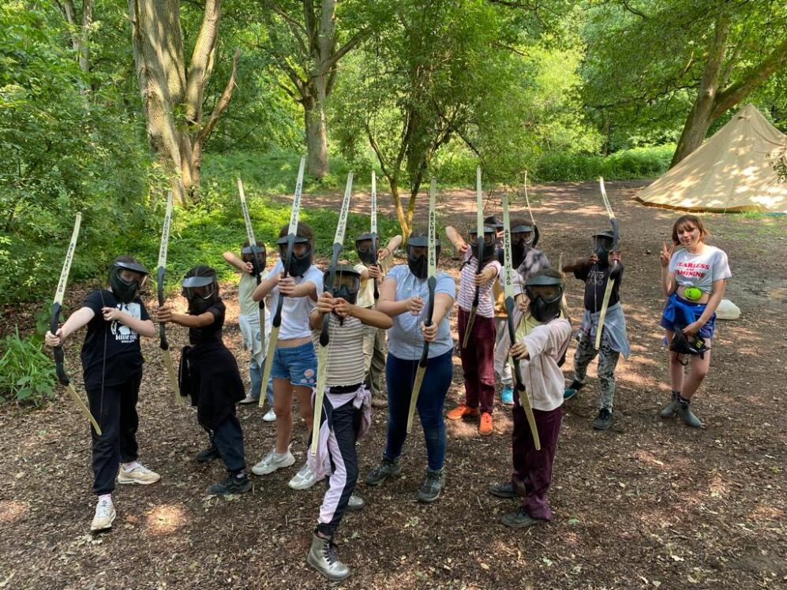
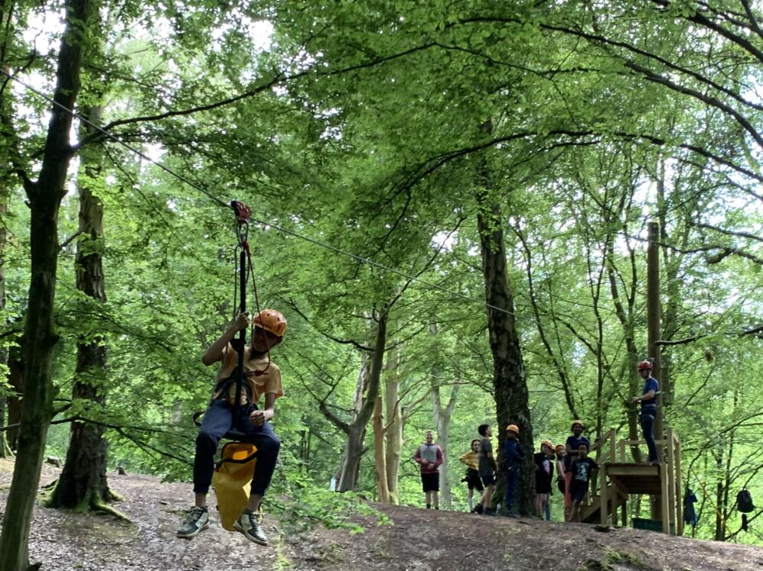
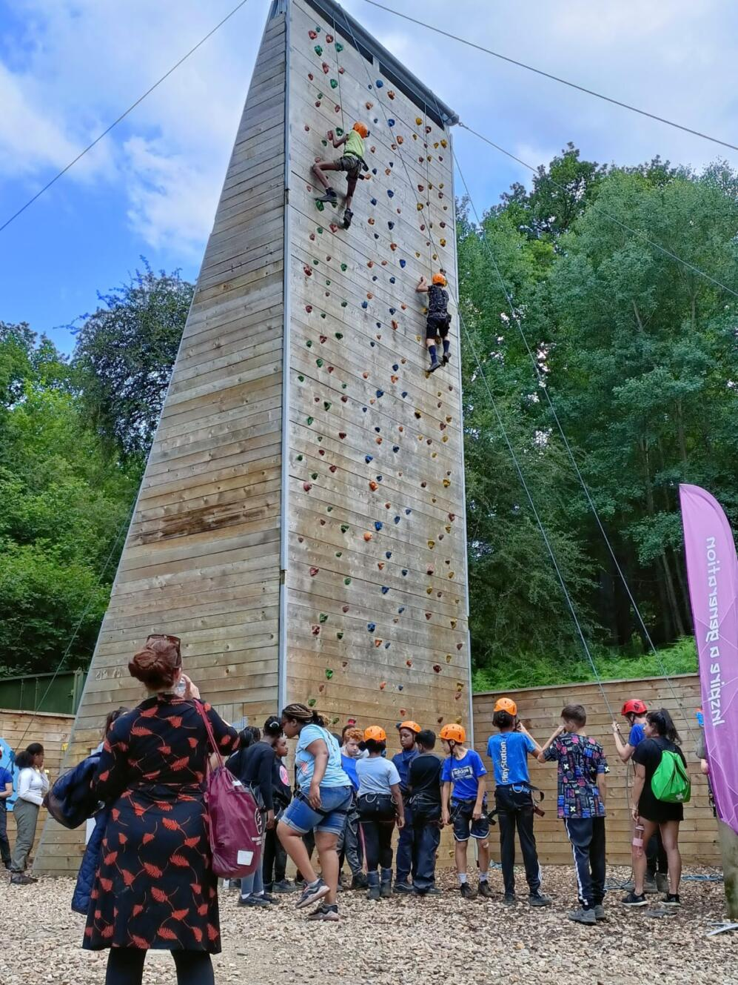
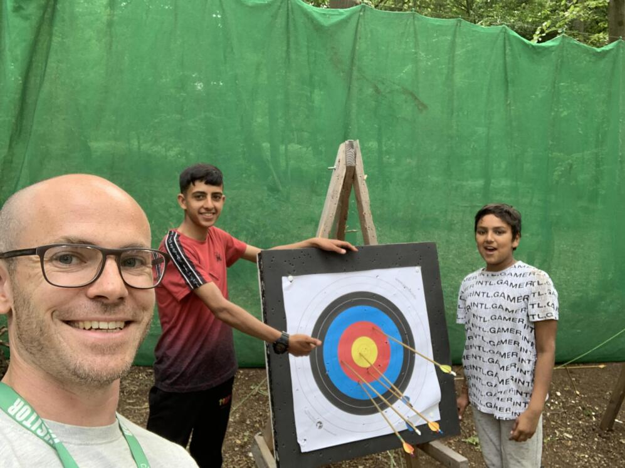
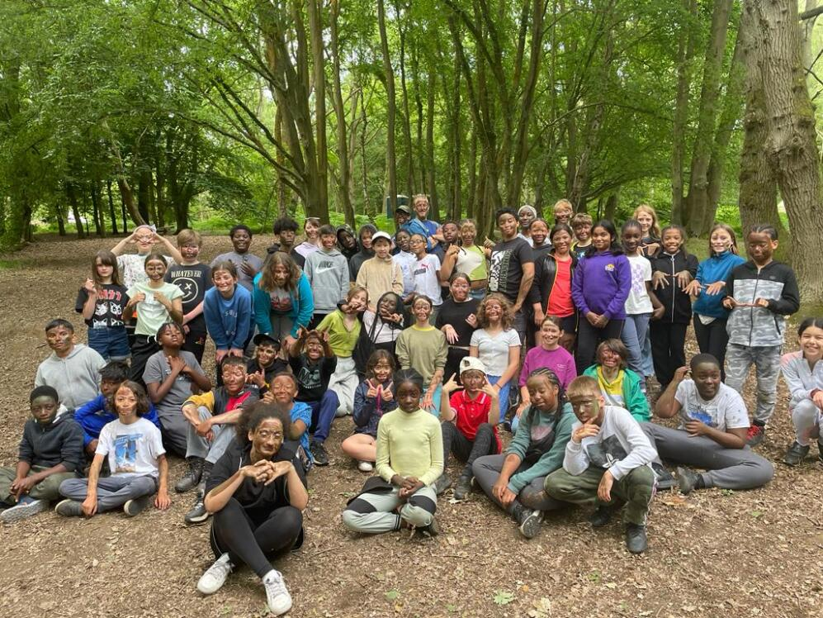
2022-23
Notes:
We want the children to have lasting memories, have experiences that are not available in inner-city London

Slide 6
Payment
Overall cost: £260, or £130 if eligible for free school meals
£20 deposit/ £10 deposit
One-off payment or monthly, regular payments
(£30 per month / £15 for FSM) due at the end of each month, open until 18th October
Contact Mrs Christopher after this date to book
Payment to be completed by 30th April 2025
Concessions

Slide 7

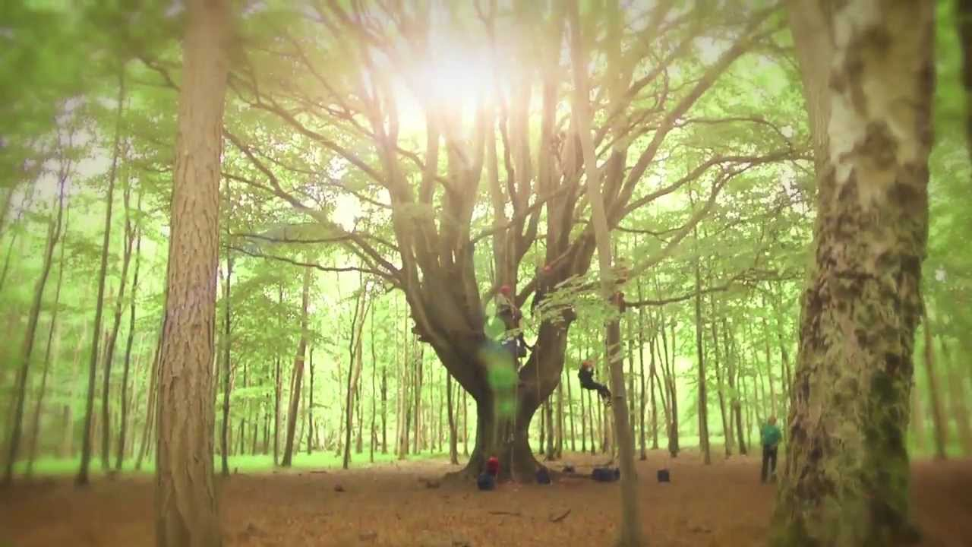
Contact & Admin.
Medical forms must be completed, medication can be administered
Pegasus Website updates
School text updates
No mobile phones
Disposable/digital cameras only
Risk assessments will be completed
School First-aiders present

Slide 8
Preparation
Sleeping bags required (season 3)
Changes of clothes
Toiletries
Medication
Sun cream, sun hat
Waterproofs
Water bottle
x Mobile phones
x Technological items
x Spending money
x Valuables
x Party clothes
x SATs revision
x Inhibitions
Notes:
The Trust may is hoping to provide some if possible. Christmas sales!

Slide 9
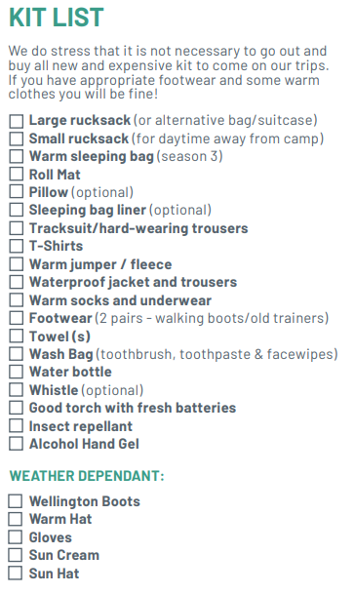

Essentials

Slide 10
Questions Welcome!
Thank you for coming

