Slide 1

Pegasus School Journey 2023-24
Jamil Francis
Cuffley
Notes:
Record Meeting!

Slide 2
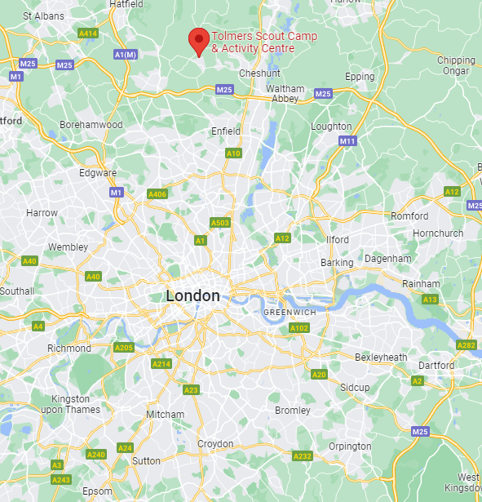
Location
Situated in woodland, roughly 1 ½ hours from Thornton Heath, Cuffley offers a range out outdoor activities such as climbing walls, high ropes and archery
Children will be camping, whilst there is a dedicated refectory.
Notes:
We want the children to have lasting memories, have experiences that are not available in inner-city London

Slide 3
Key Information
3 days, 2 nights: Wednesday 12th June, 9:00am– Friday 14th June, 4:00pm
Sleeping in tents
Outdoor, wilderness activities and experiences
Coaches arranged & paid for by the trust
All food provided
Male and female staff members from each school will attend & supervise
Encouraging as many families to send their children as possible.
Notes:
We want the children to have lasting memories, have experiences that are not available in inner-city London

Slide 4
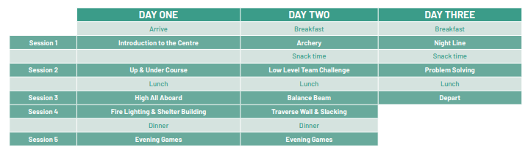
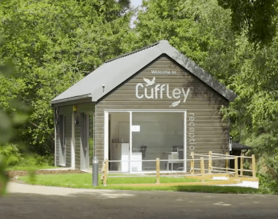
Activities
Link:
Notes:
We want the children to have lasting memories, have experiences that are not available in inner-city London

Slide 5
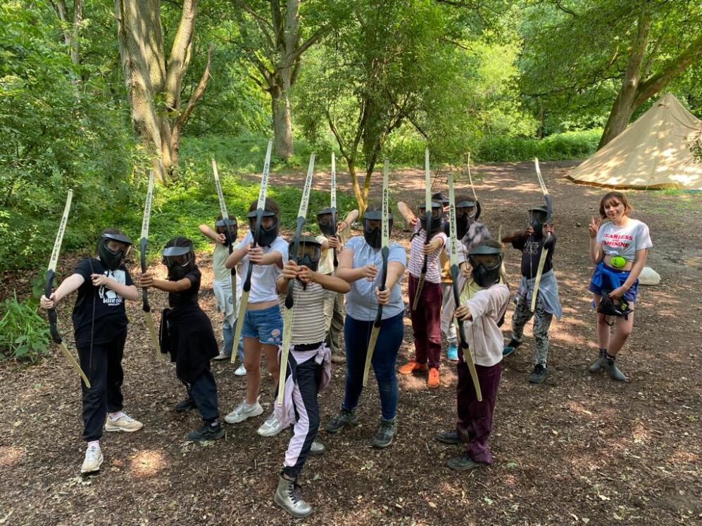
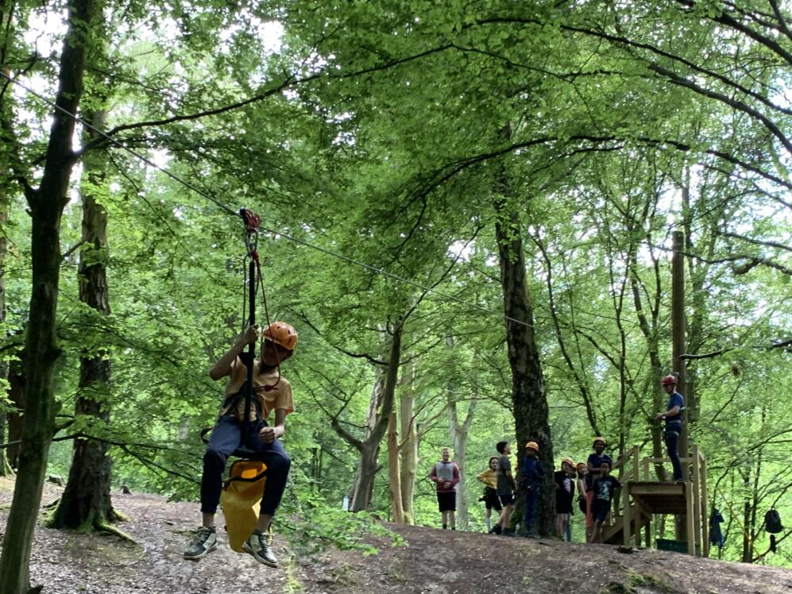
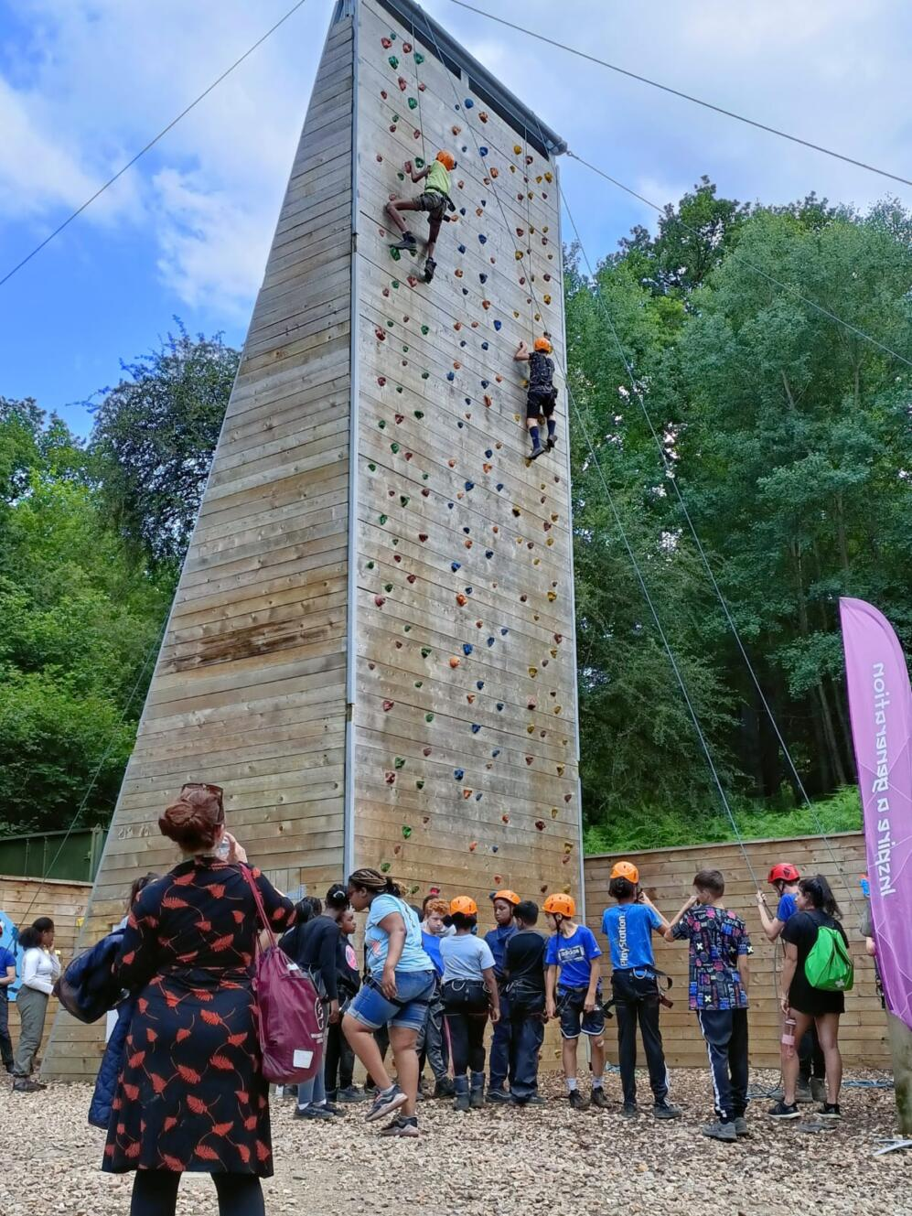
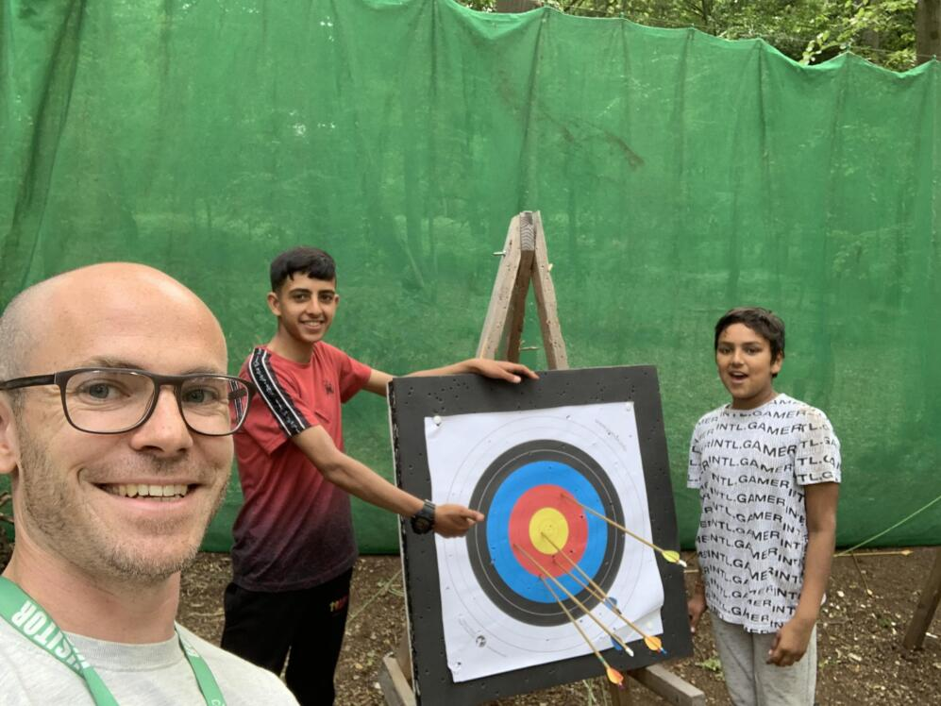
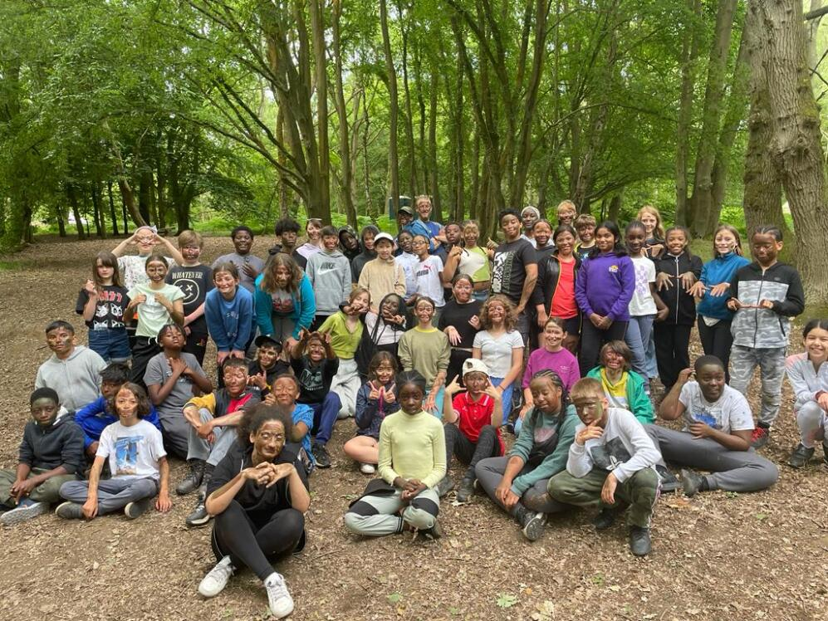
2022-23
Notes:
We want the children to have lasting memories, have experiences that are not available in inner-city London

Slide 6
Payment
Overall cost: £240, or £120 if eligible for free school meals
£30 deposit/ £15 deposit by the end of October
One-off payment or monthly, regular payments
(£35 per month/ £17.50 per month) 30th of each month
Payment to be completed by 30th April 2024
Concessions

Slide 7

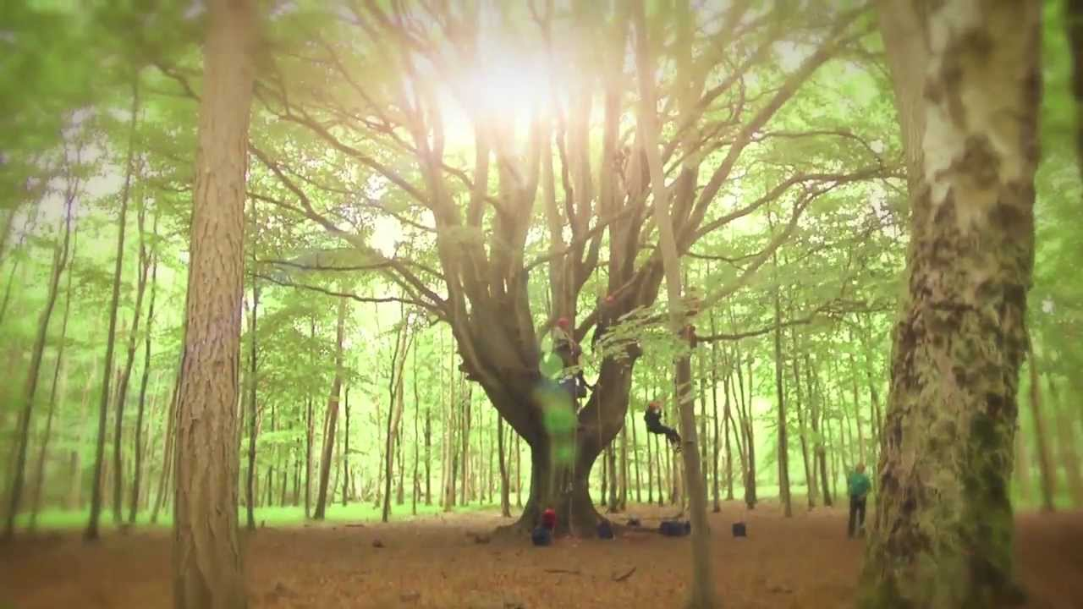
Contact & Admin.
Medical forms must be completed, medication can be administered
Pegasus Website updates
School text updates
No mobile phones
Disposable/digital cameras only
Risk assessments will be completed
School First-aiders present

Slide 8
Preparation
Sleeping bags required (season 3)
Changes of clothes
Toiletries
Medication
Sun cream, sun hat
Waterproofs
Water bottle
x Mobile phones
x Technological items
x Spending money
x Valuables
x Party clothes
x SATs revision
x Inhibitions
Notes:
The Trust may is hoping to provide some if possible. Christmas sales!

Slide 9
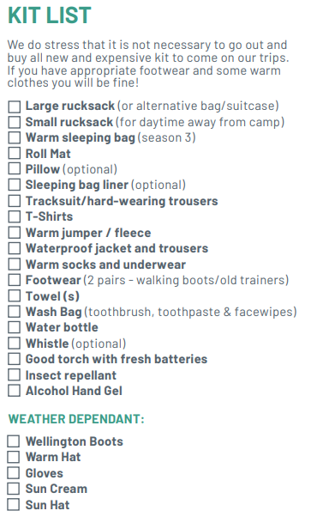

Essentials

Slide 10
Questions Welcome!
Thank you for coming

