Slide 1

Pegasus School Journey 2024-25
Cuffley
Notes:
Record Meeting!

Slide 2
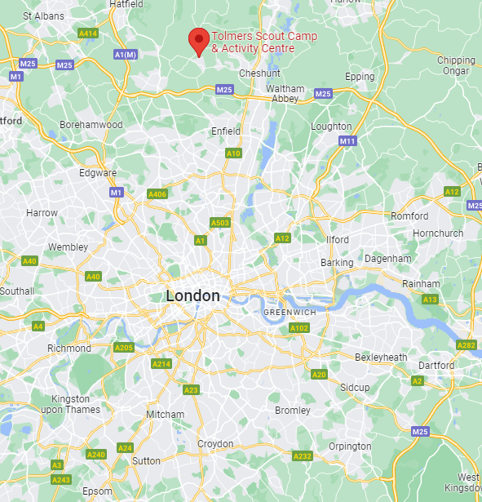
Location
Situated in woodland, roughly 1 ½ hours from Thornton Heath, Cuffley offers a range out outdoor activities such as climbing walls, high ropes and archery
Children will be camping, whilst there is a dedicated refectory & meal stations.
Notes:
We want the children to have lasting memories, have experiences that are not available in inner-city London

Slide 3
Key Information
3 days, 2 nights: Wednesday 4th June, 8:45am– Friday 6th June, 4:00pm (incorrect date on July letter)
Sleeping in tents
Outdoor, wilderness activities and experiences
Coaches to and from the site
Some camping gear required
All food provided
Male and female staff members from each school will attend & supervise
Notes:
We want the children to have lasting memories, have experiences that are not available in inner-city London

Slide 4
Coach information
Coaches to and from schools
Ensure your child gets to school for 8:00 for 8:30 departure.
Return journey:
Coaches will return to individual schools for 5:00pm
Notes:
We want the children to have lasting memories, have experiences that are not available in inner-city London

Slide 5
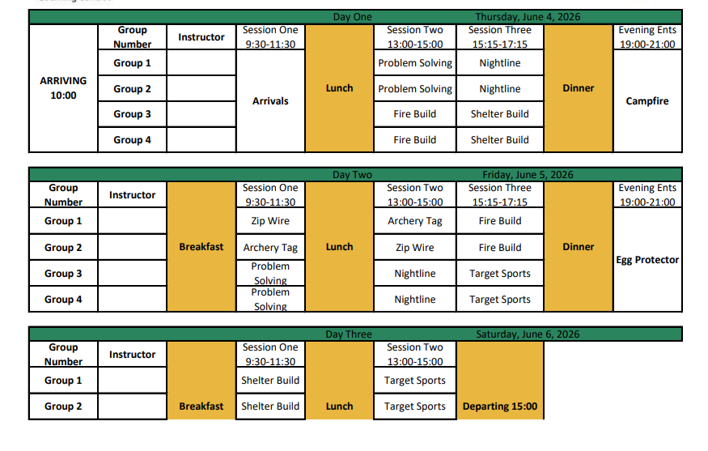
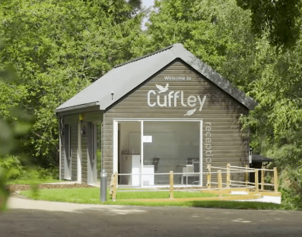
Activities
Link:
Notes:
We want the children to have lasting memories, have experiences that are not available in inner-city London

Slide 6
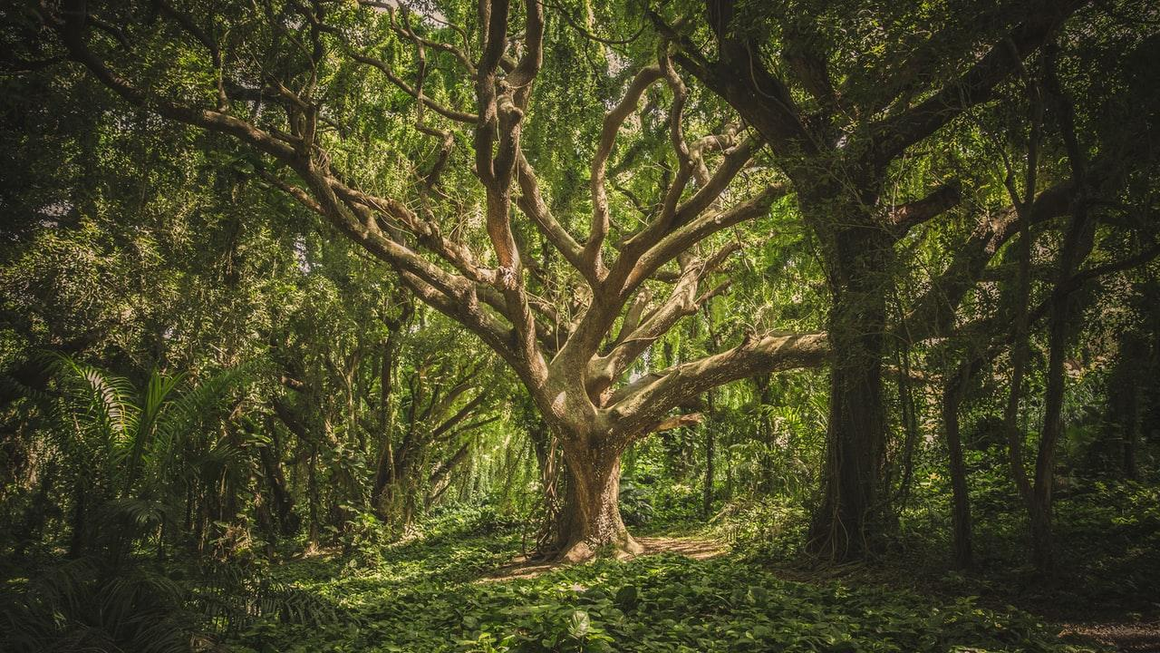
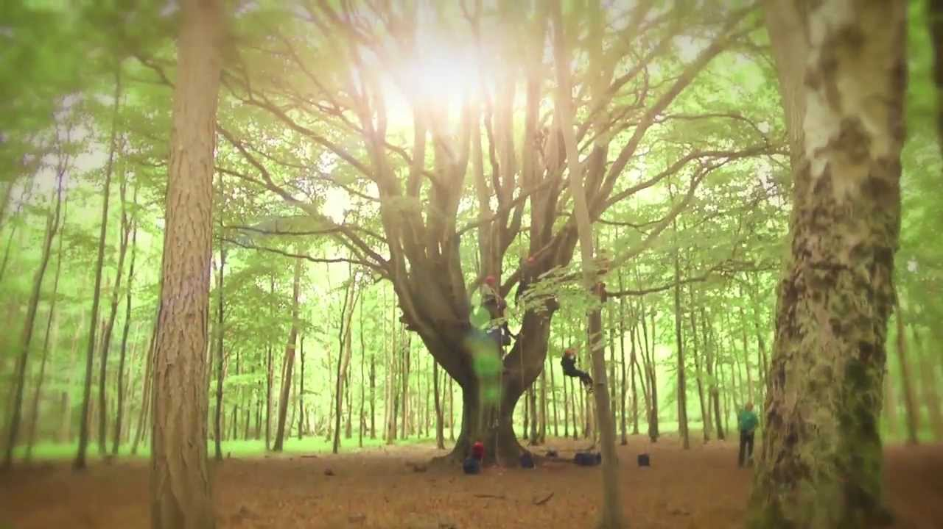
Contact & Admin.
Medical forms must be completed, medication can be administered
Pegasus Website updates
School text updates
No mobile phones
Disposable/digital cameras only
Risk assessments will be completed
School First-aiders present

Slide 7
Preparation
Sleeping bags required (season 3)
Changes of clothes – appropriate clothes
Toiletries
Medication
Sun cream, sun hat
Waterproofs
Water bottle
x Mobile phones
x Technological items
x Spending money
x Valuables
x Party clothes
x SATs revision
x Inhibitions
Notes:
The Trust may is hoping to provide some if possible. Christmas sales!

Slide 8
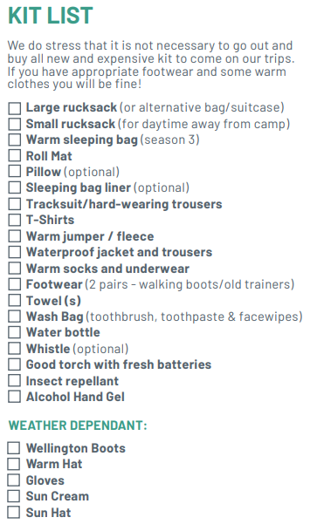
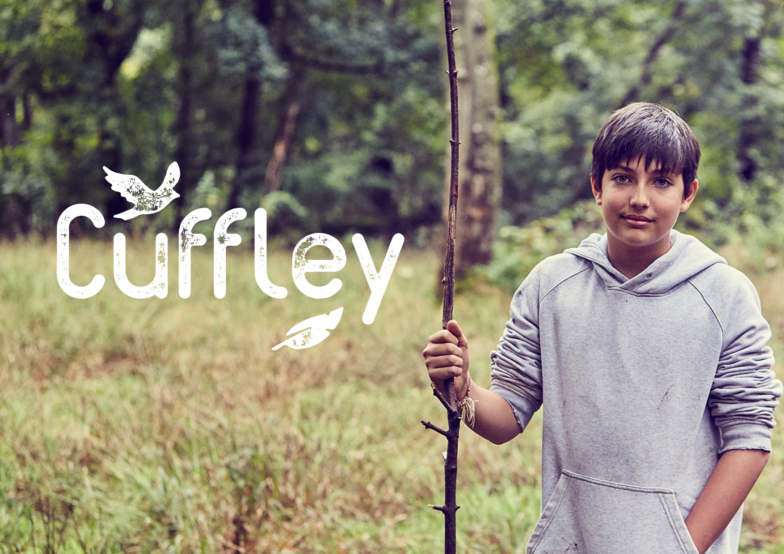
Essentials

Slide 9
Questions Welcome!
Thank you for coming

