Slide 1
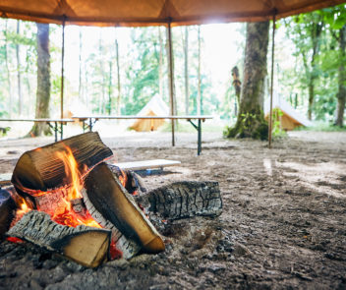

Pegasus School Journey 2021-22
Jamil Francis
Boughton Woods
Notes:
Record Meeting!

Slide 2
Key Information
3 days, 2 nights: Wednesday 18th May, 8:30am– Friday 20th May, 5:00pm
Itenary has been arranged
Coaches booked: 8:30am departure; return approx. 5p.m. – arrive promptly
Menus confirmed – dietary requirements met
Staff members confirmed
Kit lists sent out
Medical information
Sleeping arrangements organised
Notes:
We want the children to have lasting memories, have experiences that are not available in inner-city London

Slide 3
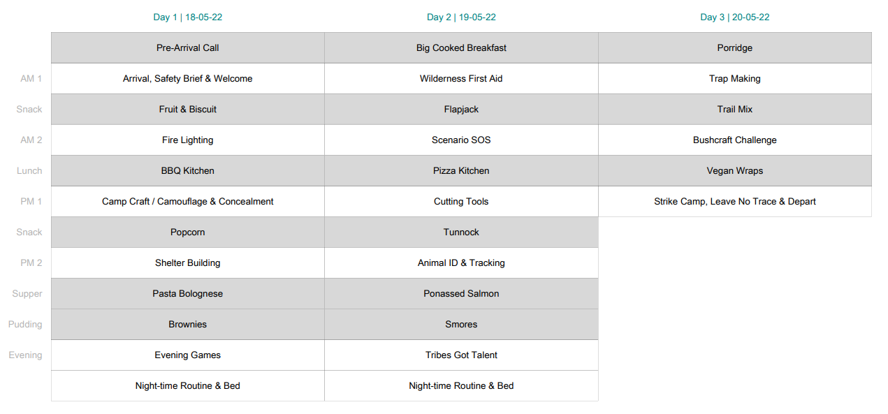
itinerary

Slide 4

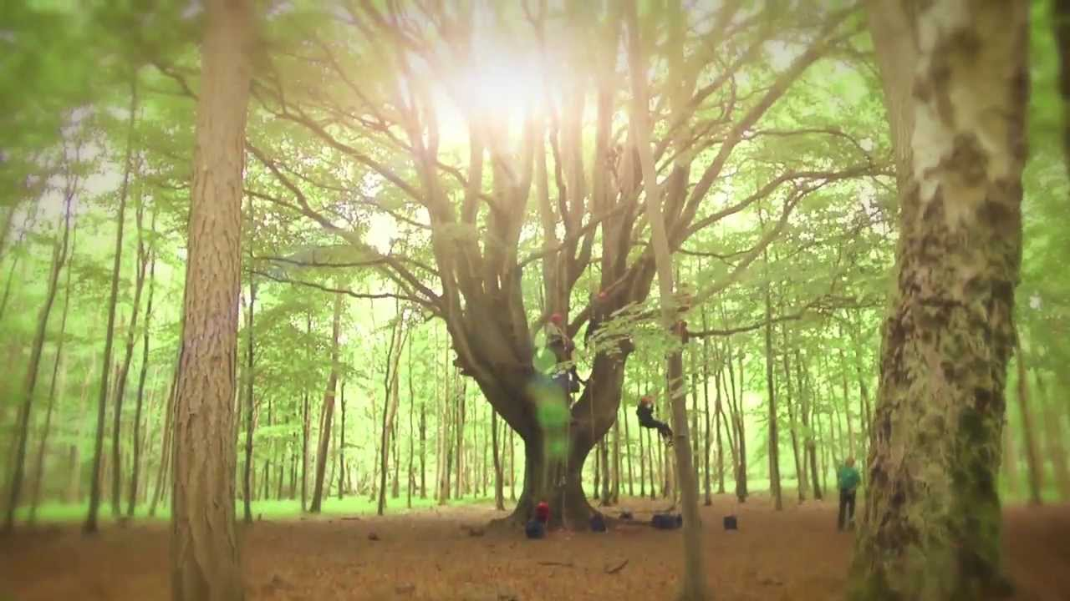
Medical
School first aiders as well as on-site staff
Medical forms must have been completed
Medication should be in a bag, labelled with child’s name and instructions
Permission to give calpol

Slide 5
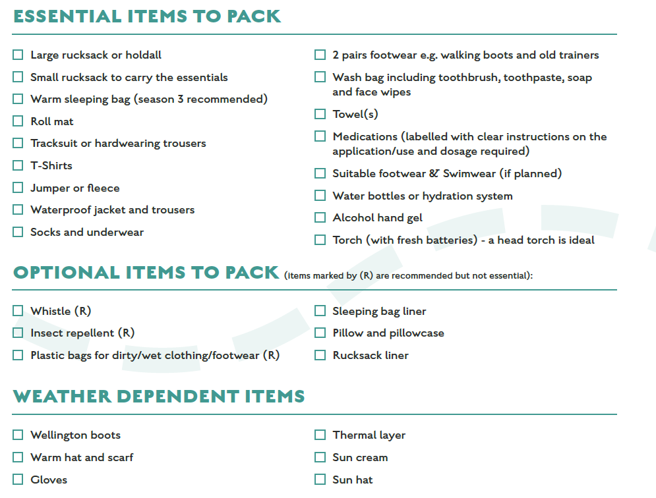
Kit

Slide 6
Contact & updates.
In an emergency, we will call directly with details provided
If you need to contact a child, call the school office to arrange this
Regular updates will be posted on the school website
No children’s mobile phones
Disposable/digital cameras only

Slide 7
Preparation
Label your child’s name on everything!
Give them a list of what is packed
Check the weather forecast, then pack for all eventualities anyway!
Discuss any potential issues with staff
x Mobile phones
x Technological items
x Spending money
x Valuables
x Party clothes
x SATs revision
x Inhibitions
Notes:
The Trust may is hoping to provide some if possible. Christmas sales!

Slide 8
Questions Welcome!
Thank you for coming

