Slide 1

Pegasus School Journey 2023-24
Jamil Francis
Cuffley
Notes:
Record Meeting!

Slide 2
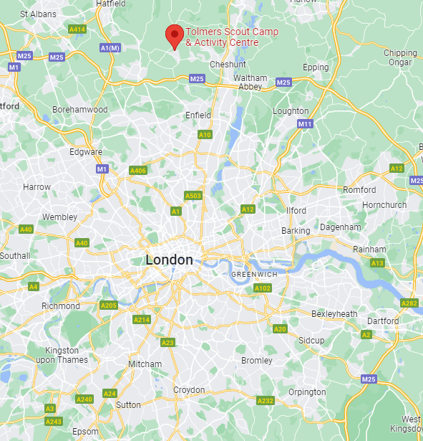
Location
Situated in woodland, roughly 1 ½ hours from Thornton Heath, Cuffley offers a range out outdoor activities such as climbing walls, high ropes and archery
Children will be camping, whilst there is a dedicated refectory.
Notes:
We want the children to have lasting memories, have experiences that are not available in inner-city London

Slide 3
Key Information
3 days, 2 nights: Wednesday 12th June, 9:00am– Friday 14th June, 4:00pm
Sleeping in tents
Outdoor, wilderness activities and experiences
Coaches arranged & paid for by the trust
All food provided
Male and female staff members from the trust will attend & supervise
Drinking water points throughout the site
Toilet and shower blocks
ALC staff on call 24/7
Notes:
We want the children to have lasting memories, have experiences that are not available in inner-city London

Slide 4
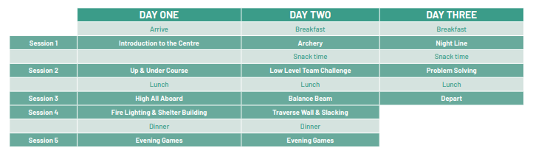
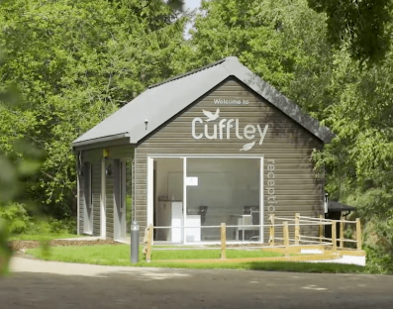
Activities
Link:
Notes:
We want the children to have lasting memories, have experiences that are not available in inner-city London

Slide 5
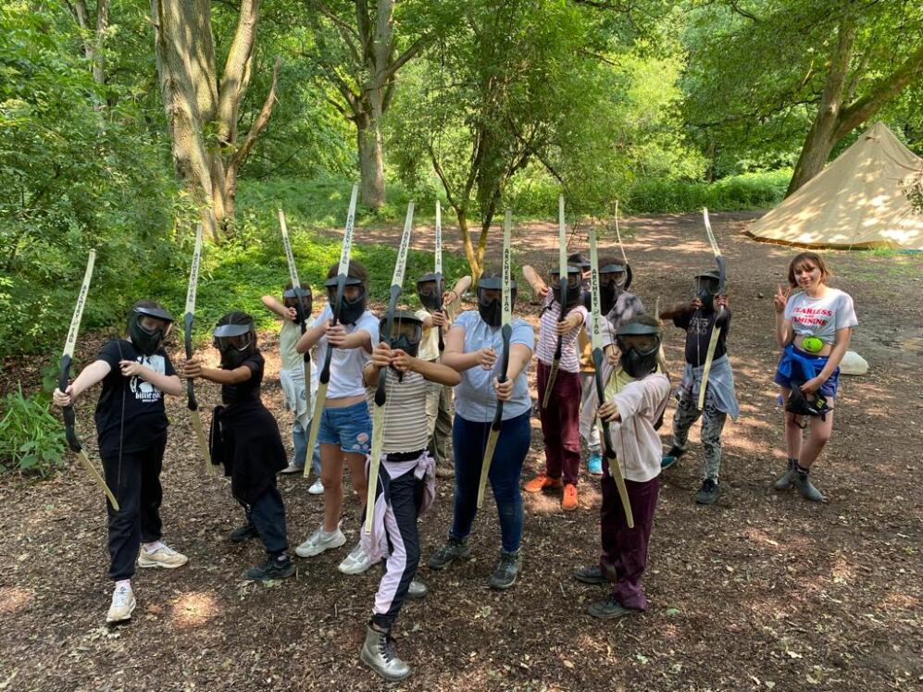
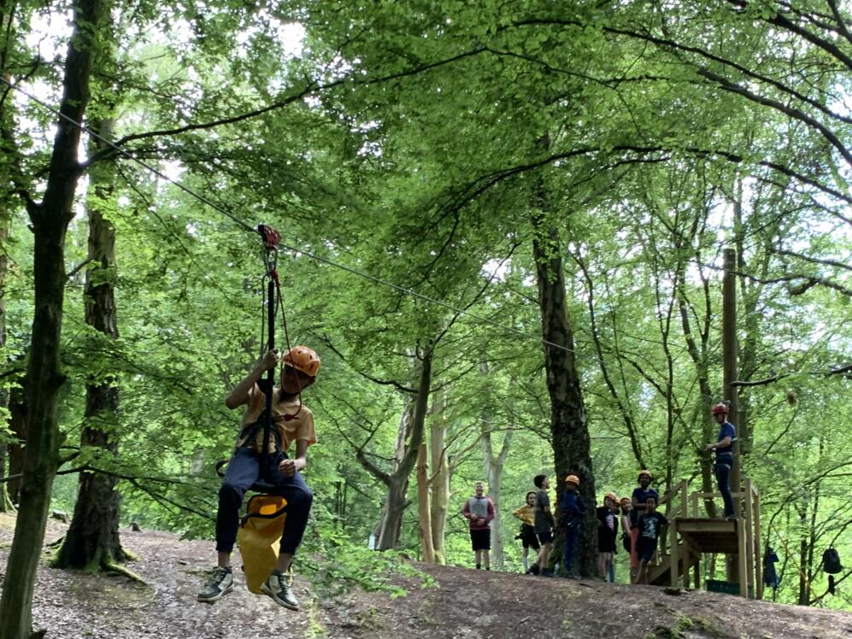
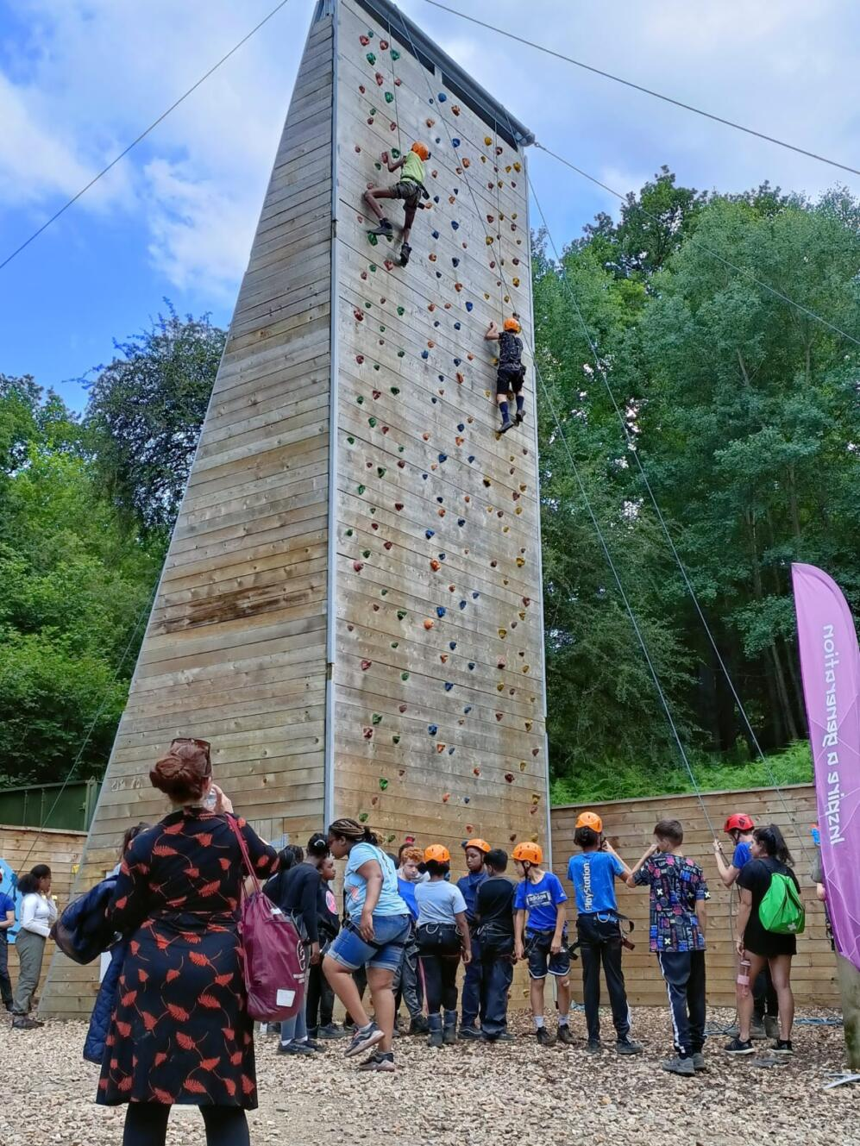
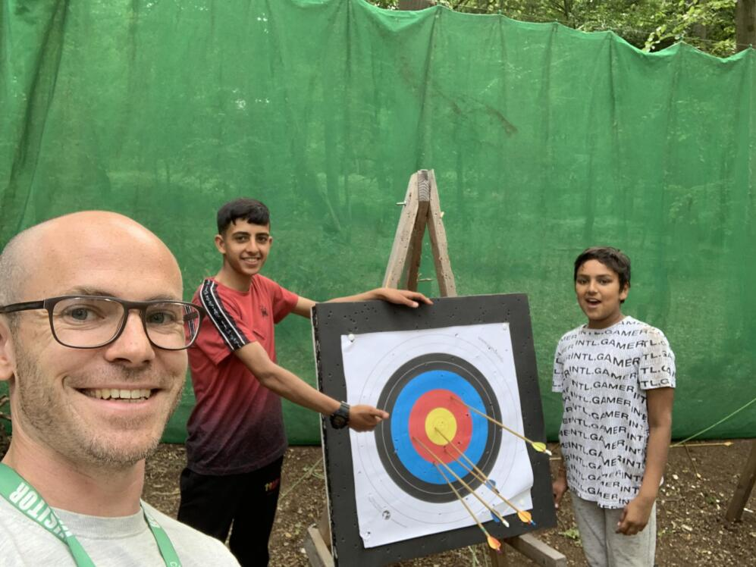
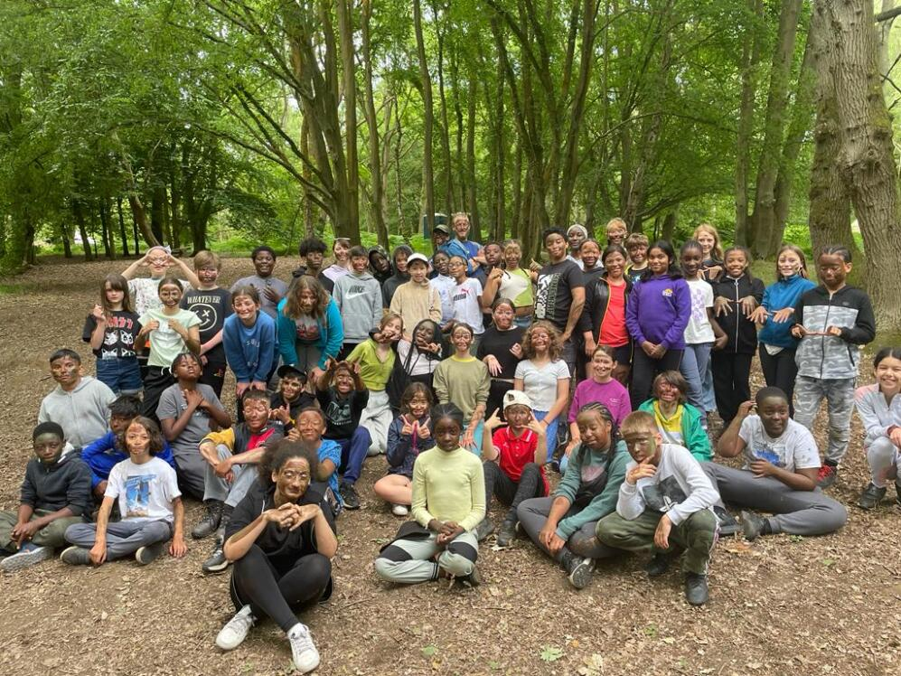
2022-23
Notes:
We want the children to have lasting memories, have experiences that are not available in inner-city London

Slide 6
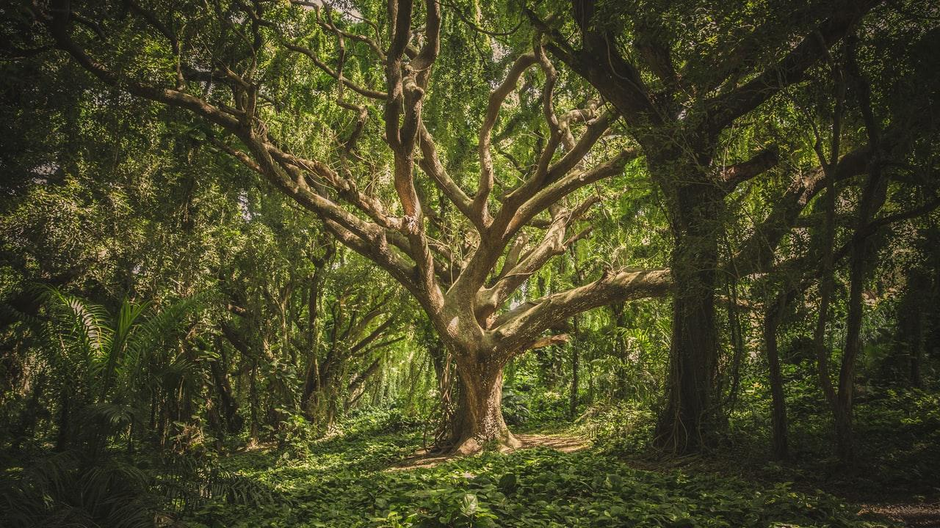
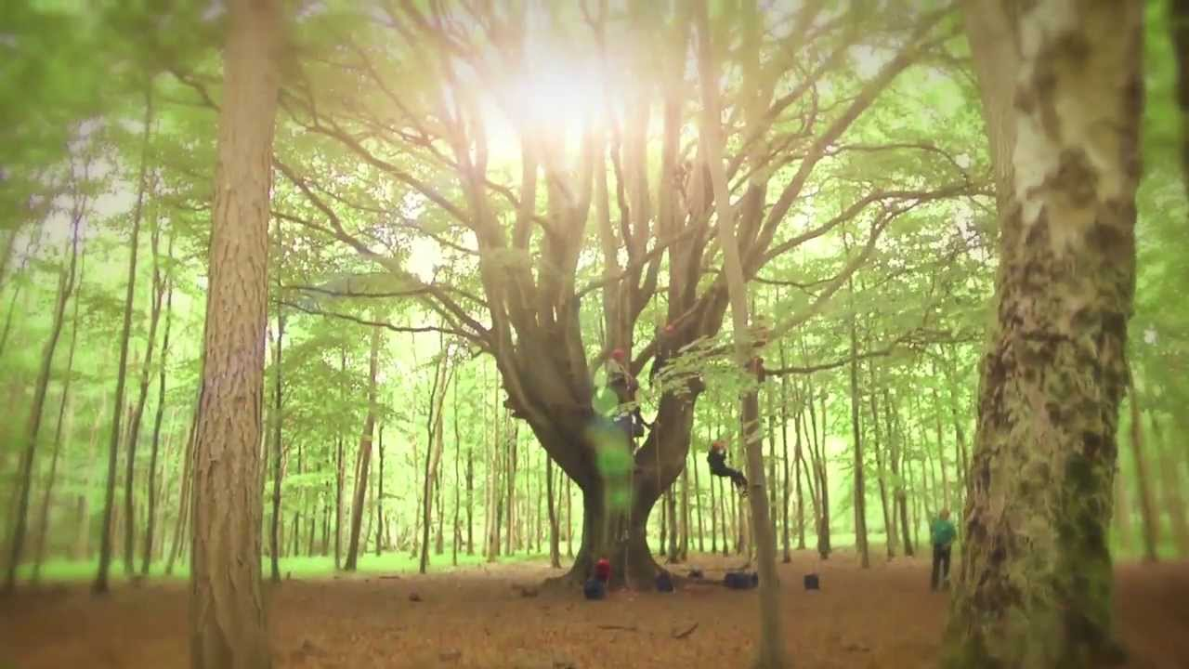
Contact & Admin.
Medication must be sent in a named ziplock/sandwich bag, with instructions
Pegasus Website updates & photos
School text updates
No mobile phones
Disposable/digital cameras only
School First-aiders present
Showers are available

Slide 7
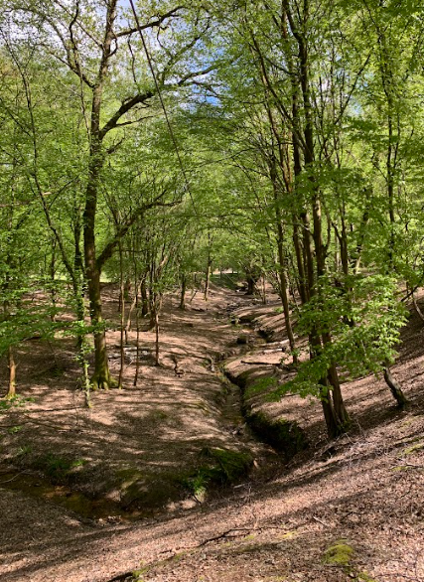
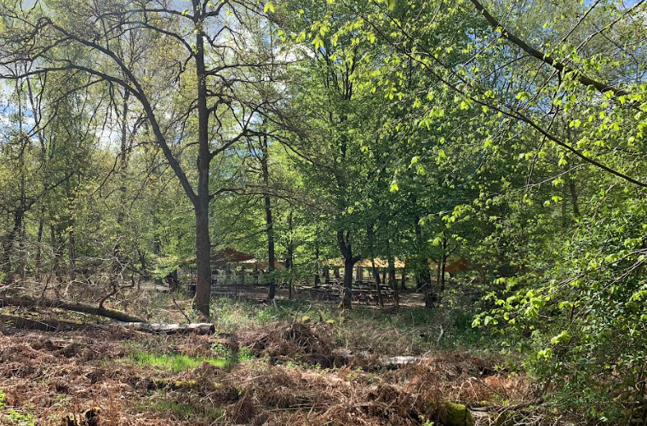
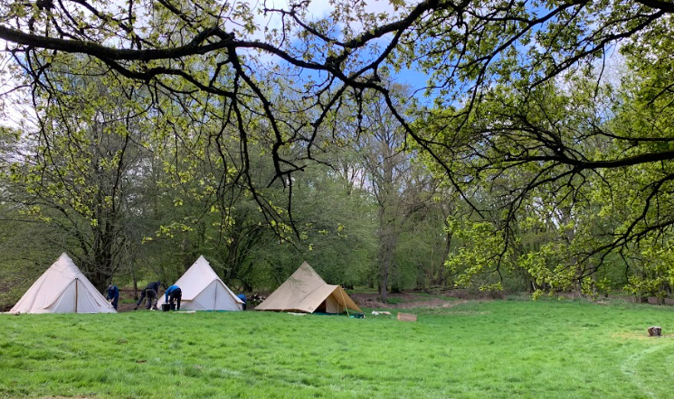
2024 visit
Notes:
We want the children to have lasting memories, have experiences that are not available in inner-city London

Slide 8
Preparation
Sleeping bags required (season 2+ recommended)
Changes of clothes
Toiletries
Medication
Sun cream, sun hat
Waterproofs
Water bottle
Old clothes & footwear
Torch
x Mobile phones
x Technological items
x Spending money
x Valuables
x Party clothes
x SATs revision
x Inhibitions
Label everything!
Notes:
The Trust may is hoping to provide some if possible. Christmas sales!

Slide 9
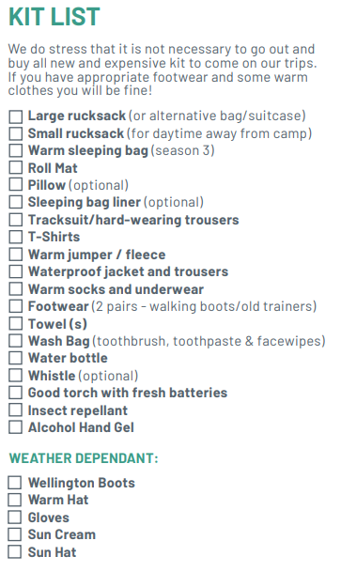
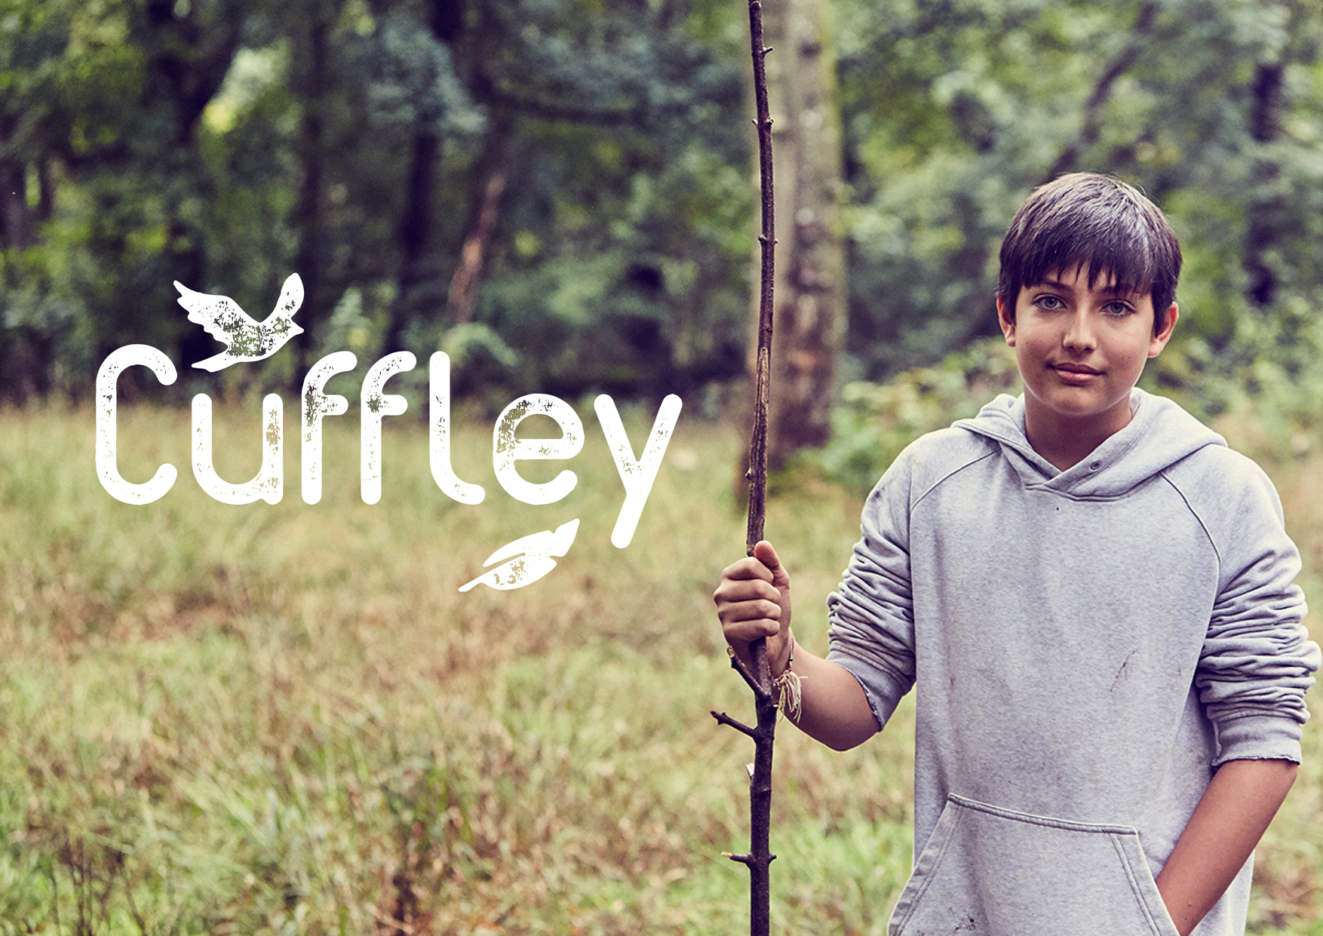
Essentials

Slide 10
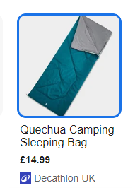
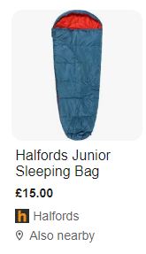
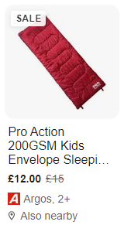
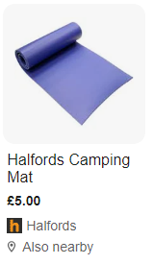
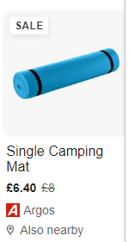
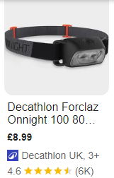
Bed rolls/ roll mats
(Yoga mats are also fine)
Sleeping bags –Season 1 are the lightest-weight, up to season 3 & 4.
Thickness/warmth measured in gsm. (200+ ideally)
Torches – head torches are ideal for getting up in the night

Slide 11
Questions Welcome!
Thank you for coming

