Slide 1
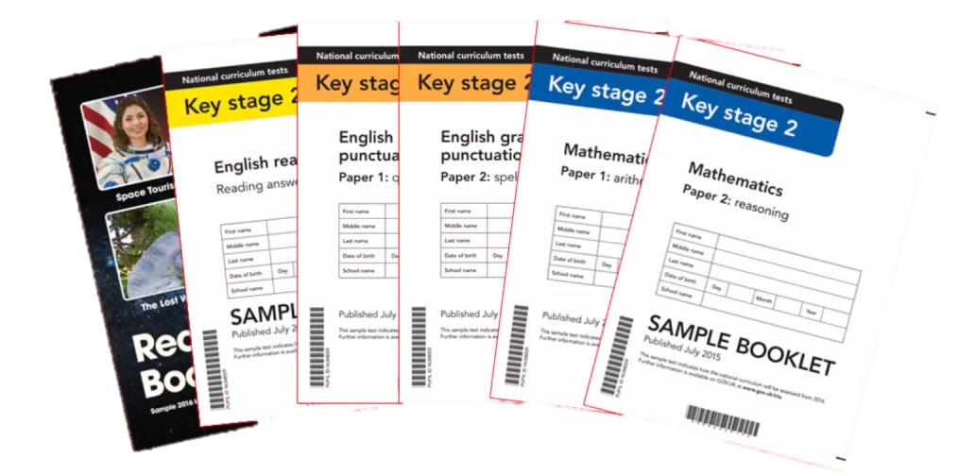
End of KS2 Assessments
2023-24

Slide 2
Aims:
We want you to have a better understanding of what your children will be expected to do in the 2024 SATs.
We want you to be aware of:
When the SATs are
How long each Paper is
Example questions
How you can support your child
The tests are in place to track children’s progress from Key Stage One, so it’s a great chance to recognise how far they’ve come!

Slide 3
The week commencing 13th May,
your children will be sitting a week of tests.
The timetable for that week is as follows:
Monday 13th May – Grammar Punctuation and Spelling Papers 1 and 2
Tuesday 14th May – Reading Paper
Wednesday 15th May – Maths Arithmetic Paper 1 and Maths Reasoning Paper 2
Thursday 16th May – Maths Reasoning Paper 3

Slide 4
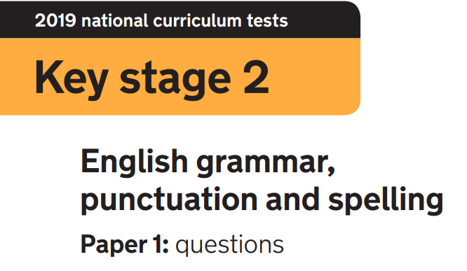

Paper 1: questions
45 minutes
50 questions to be completed
Marked out of 50 as all the questions are worth 1 mark
Paper 2: spelling
No time limit because the spellings and example sentences are read out by the test administrator (usually the class teacher)
20 spellings
Marked out of 20
The results of the grammar paper and spelling test are added
together to give a combined score out of 70.

Slide 5
The grammar paper tests your child’s ability in 7 areas:
Grammatical terms / word classes
Functions of sentences
Combining words, phrases and clauses
Verb forms, tenses and consistency
Punctuation
Vocabulary
Standard English and formality

Slide 6
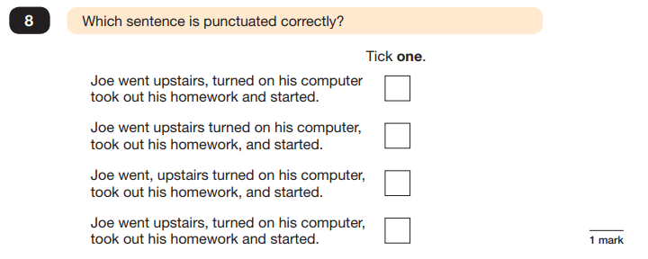
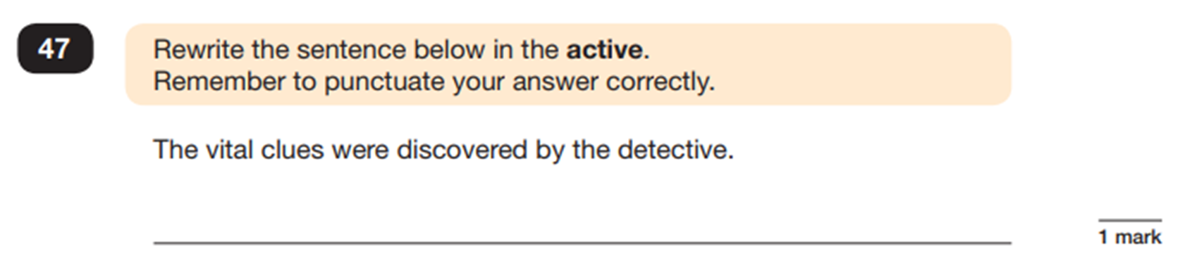
The questions paper is also made up of different types of questions:
Multiple-choice answers
For some questions, you do not need to do any writing. Read the instructions
carefully so that you know how to answer each question.
Short answers Some questions are followed by a line or a box. This shows that you need to write a word, a few words or a sentence.

Slide 7
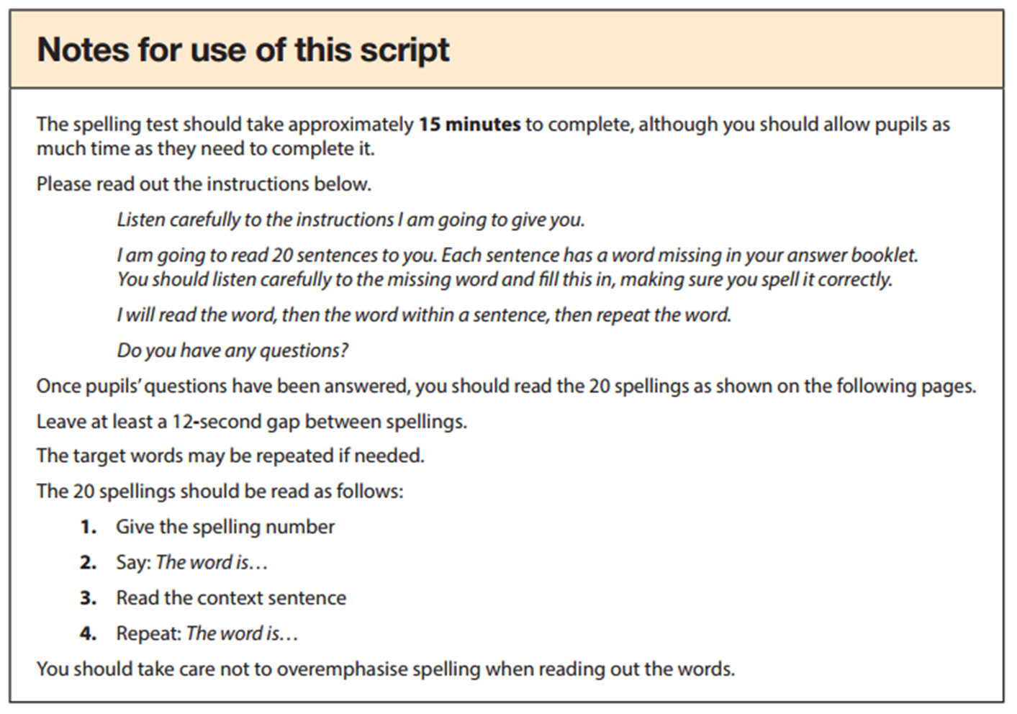
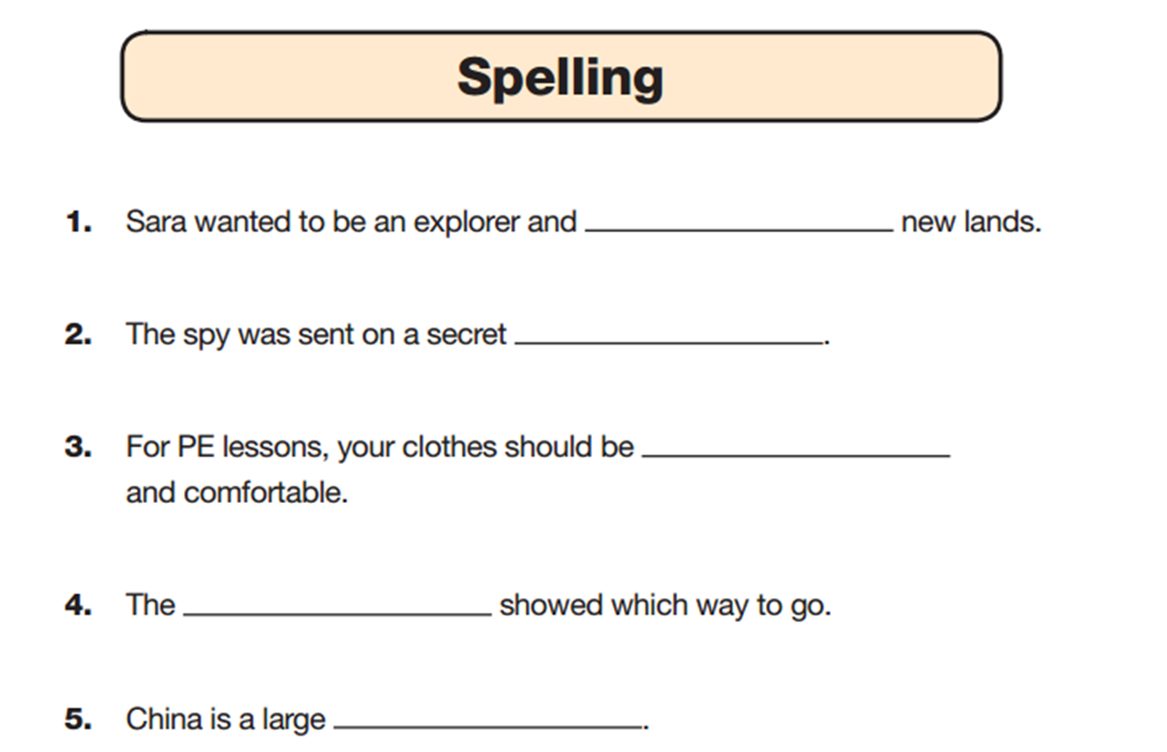
The spelling paper is usually administered by the class teacher.
This is the example script:
This is what the answer booklet looks like:

Slide 8
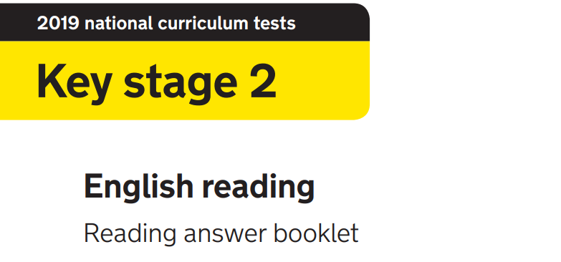
1 hour
The reading booklet consists of 3 texts
The answer booklet usually has 39 / 40 questions to be completed
Marked out of 50 as some questions are worth more than one mark.

Slide 9
The reading paper tests your child’s ability in 8 areas:
Give / explain the meaning of words in context.
Retrieve and record information / identify key details from a text.
Summarise main ideas from more than one paragraph.
Make inferences and explain and justify them with evidence from the text.
Predict what might happen from details implied and stated.
Identify / explain how information or narrative contributes to the meaning of the text as a whole.
Identify / explain how meaning is enhance through choice of words and phrases.
Make comparisons within the text.

Slide 10
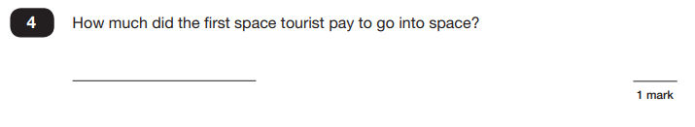
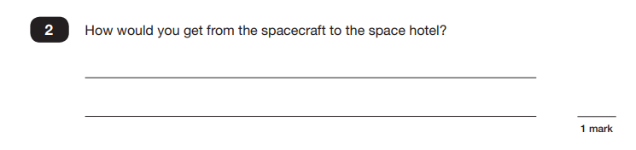
The reading paper consists of a variety of question types:
Short answers
Some questions are followed by a short line or box. This shows that you need only write a word or a few words in your answer.
Several line answers
Some questions are followed by a few lines. This gives you space to write more words or a sentence or two.

Slide 11
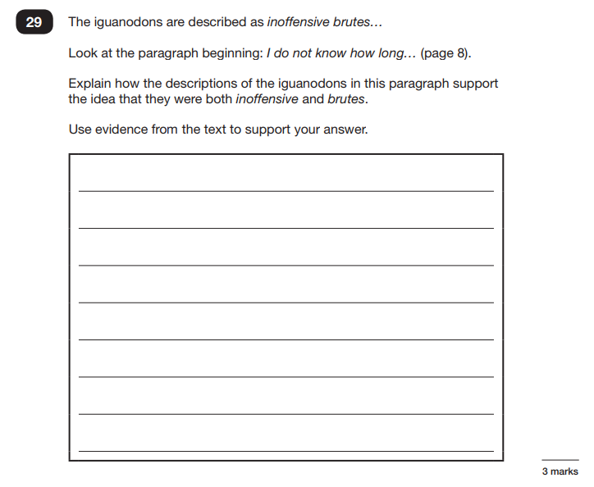
Longer answers
Some questions are followed by more answer lines. This shows that a longer, more detailed answer is needed to explain your opinion. You can write in full sentences if you want to.
In previous years, the paper was most heavily weighted towards testing the children’s inferencing skills, often using questions that require longer more detailed answers that are worth 3 points:

Slide 12
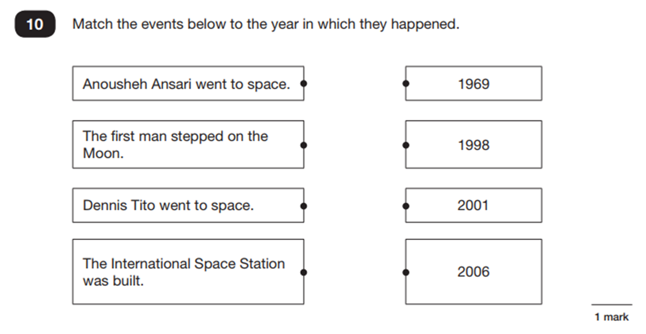
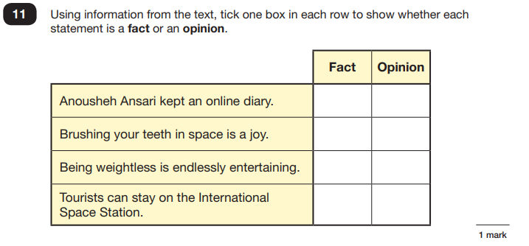
Selected answers
For some questions you do not need to write anything at all and you should tick, draw lines to, or circle your answer. Read the instructions carefully so that you know how to answer the question.

Slide 13
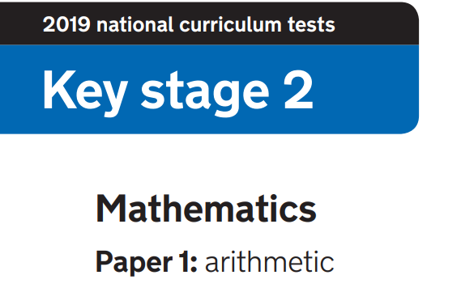
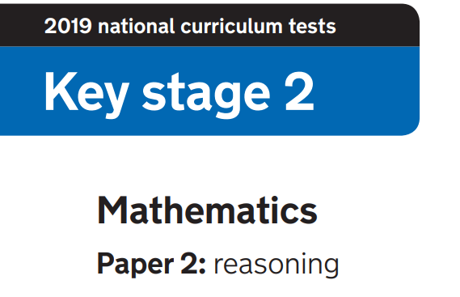
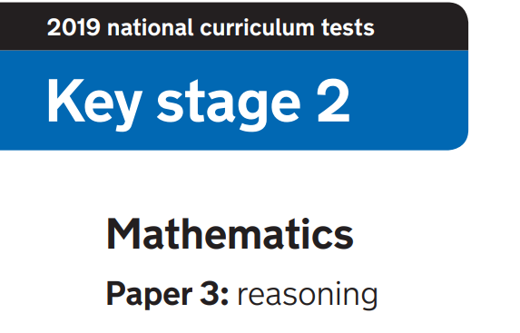
Paper 1: arithmetic
30 minutes
36 questions to be completed
Marked out of 40 as the long division and long multiplication questions are marked out of 2
Papers 2 and 3: reasoning
40 minutes each
Number of questions vary as does the
number of marks given for each answer
Both papers are marked out of 35
The results of the arithmetic paper and the 2 reasoning papers
are added together to give a combined score out of 110.

Slide 14
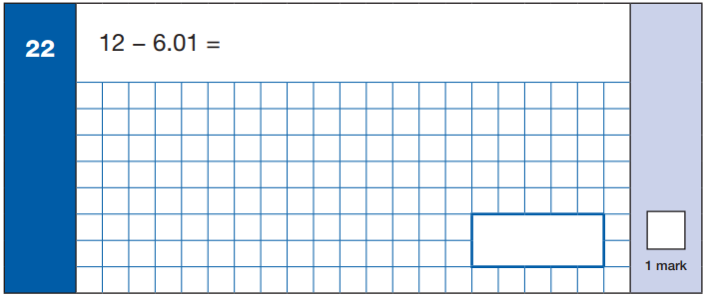
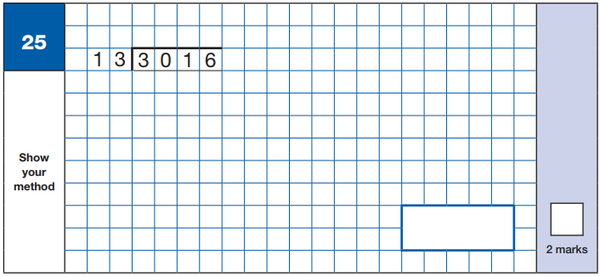
The arithmetic paper is about pure mathematics using written and mental strategies.
By demonstrating use of the correct method, a mark can be gained from the questions worth 2 marks even if the child has got the actual answer wrong.

Slide 15
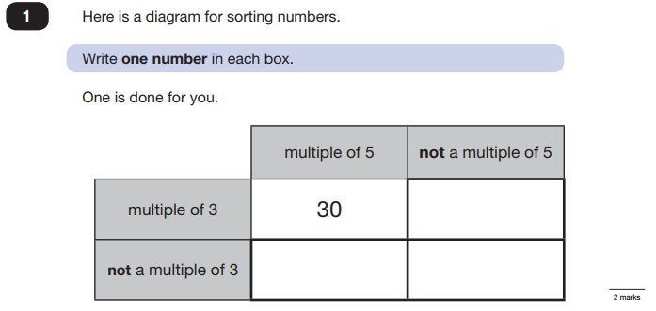
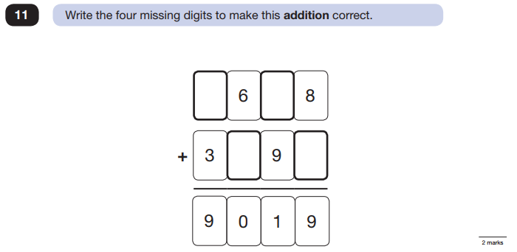
The 2 maths reasoning papers test the children’s ability to use their mathematical skills to solve problems. The children need to interpret what mathematical knowledge or processes are being presented in the question.
Some of the questions involve reasoning where to place numbers.

Slide 16
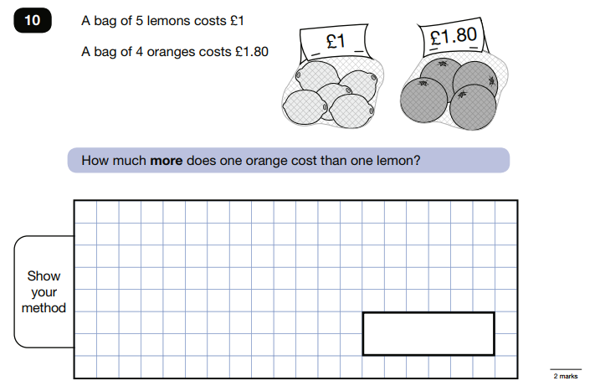
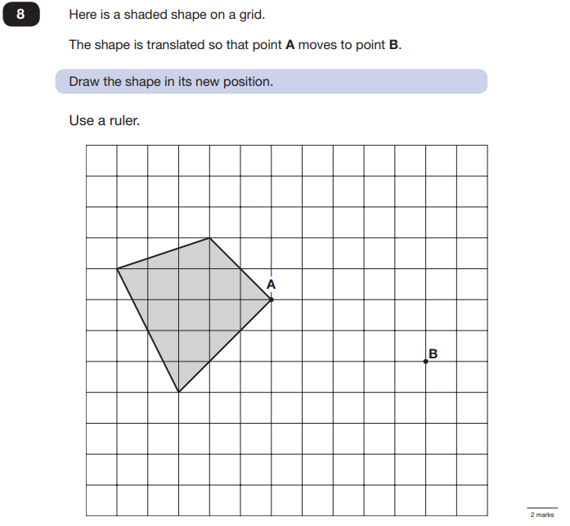
Some of the questions involve reasoning with word problems.
Some of the questions involve using their understanding of geometry.

Slide 17
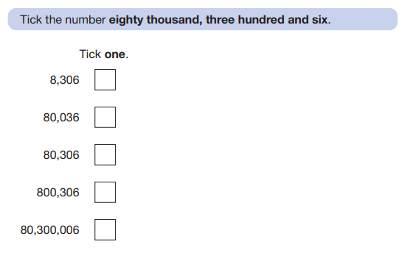
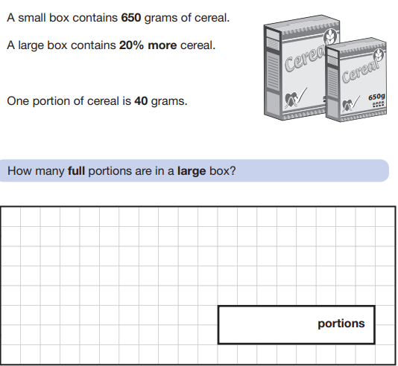
Remember, they are Key Stage Two tests, not Year Six tests.
So some are simpler (year 3/4 level)…
…some are trickier!

Slide 18
What can you do to help your child?
Make sure your child reads every day and ask them about what they are reading.
Help your child learn the spelling rules taught at school.
Ensure your child is secure in their times tables – they can do this by using ‘Times Tables Rockstars’.
Ensure your child completes their Mathletics homework every week.
Ensure that your child sleeps 10 hours a night and eats healthily.
If your child is unwell on the day of the test, please call the school as soon as possible to decide together what to do.
And remember that the SATs do not define your child!

Slide 19

Any questions?

