Slide 1


Slide 2
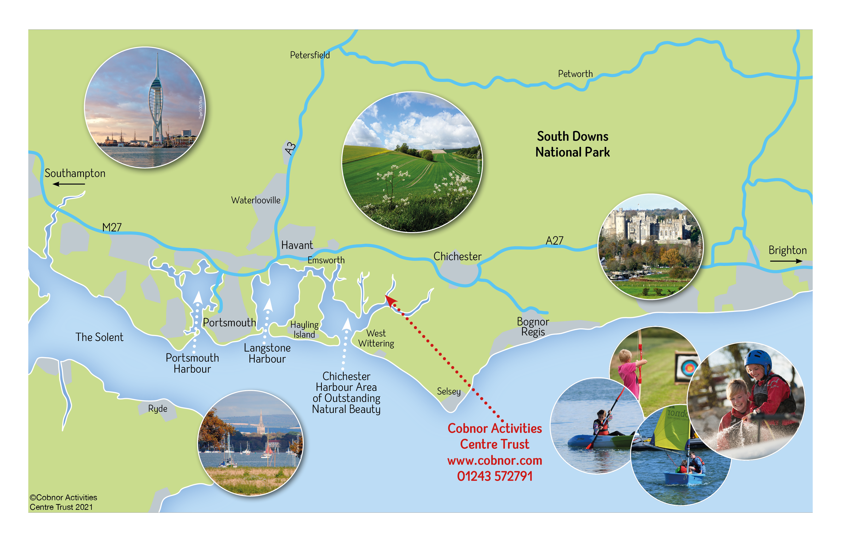
We are located between Chichester and Portsmouth, on the Chidham peninsula. We are part of Chichester Harbour AONB, with access to the water at all states of the tide and have great views of the South Downs.
LOCATION

Slide 3





ABOUT US
Cobnor Activities Centre Trust (CACT) is an independent charity:
Providing high-quality, educational and fun outdoor activities.
Located in Chichester Harbour, a designated National Landscape.
Activities include aeroball, archery, campcraft, climbing, sailing, paddle sports and more!
RYA Onboard, Sailability and Paddle UK Paddle-Ability programmes offered for individuals with learning and physical disabilities.
Every activity promotes achievement, physical engagement, mental health, well-being and self-esteem.
We aim to empower participants to lead active lives and enhance their long-term personal and life skills.

Slide 4







Slide 5
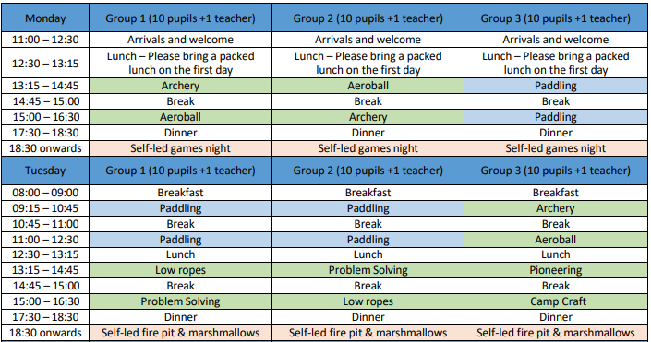
Example Activity Programme

Slide 6

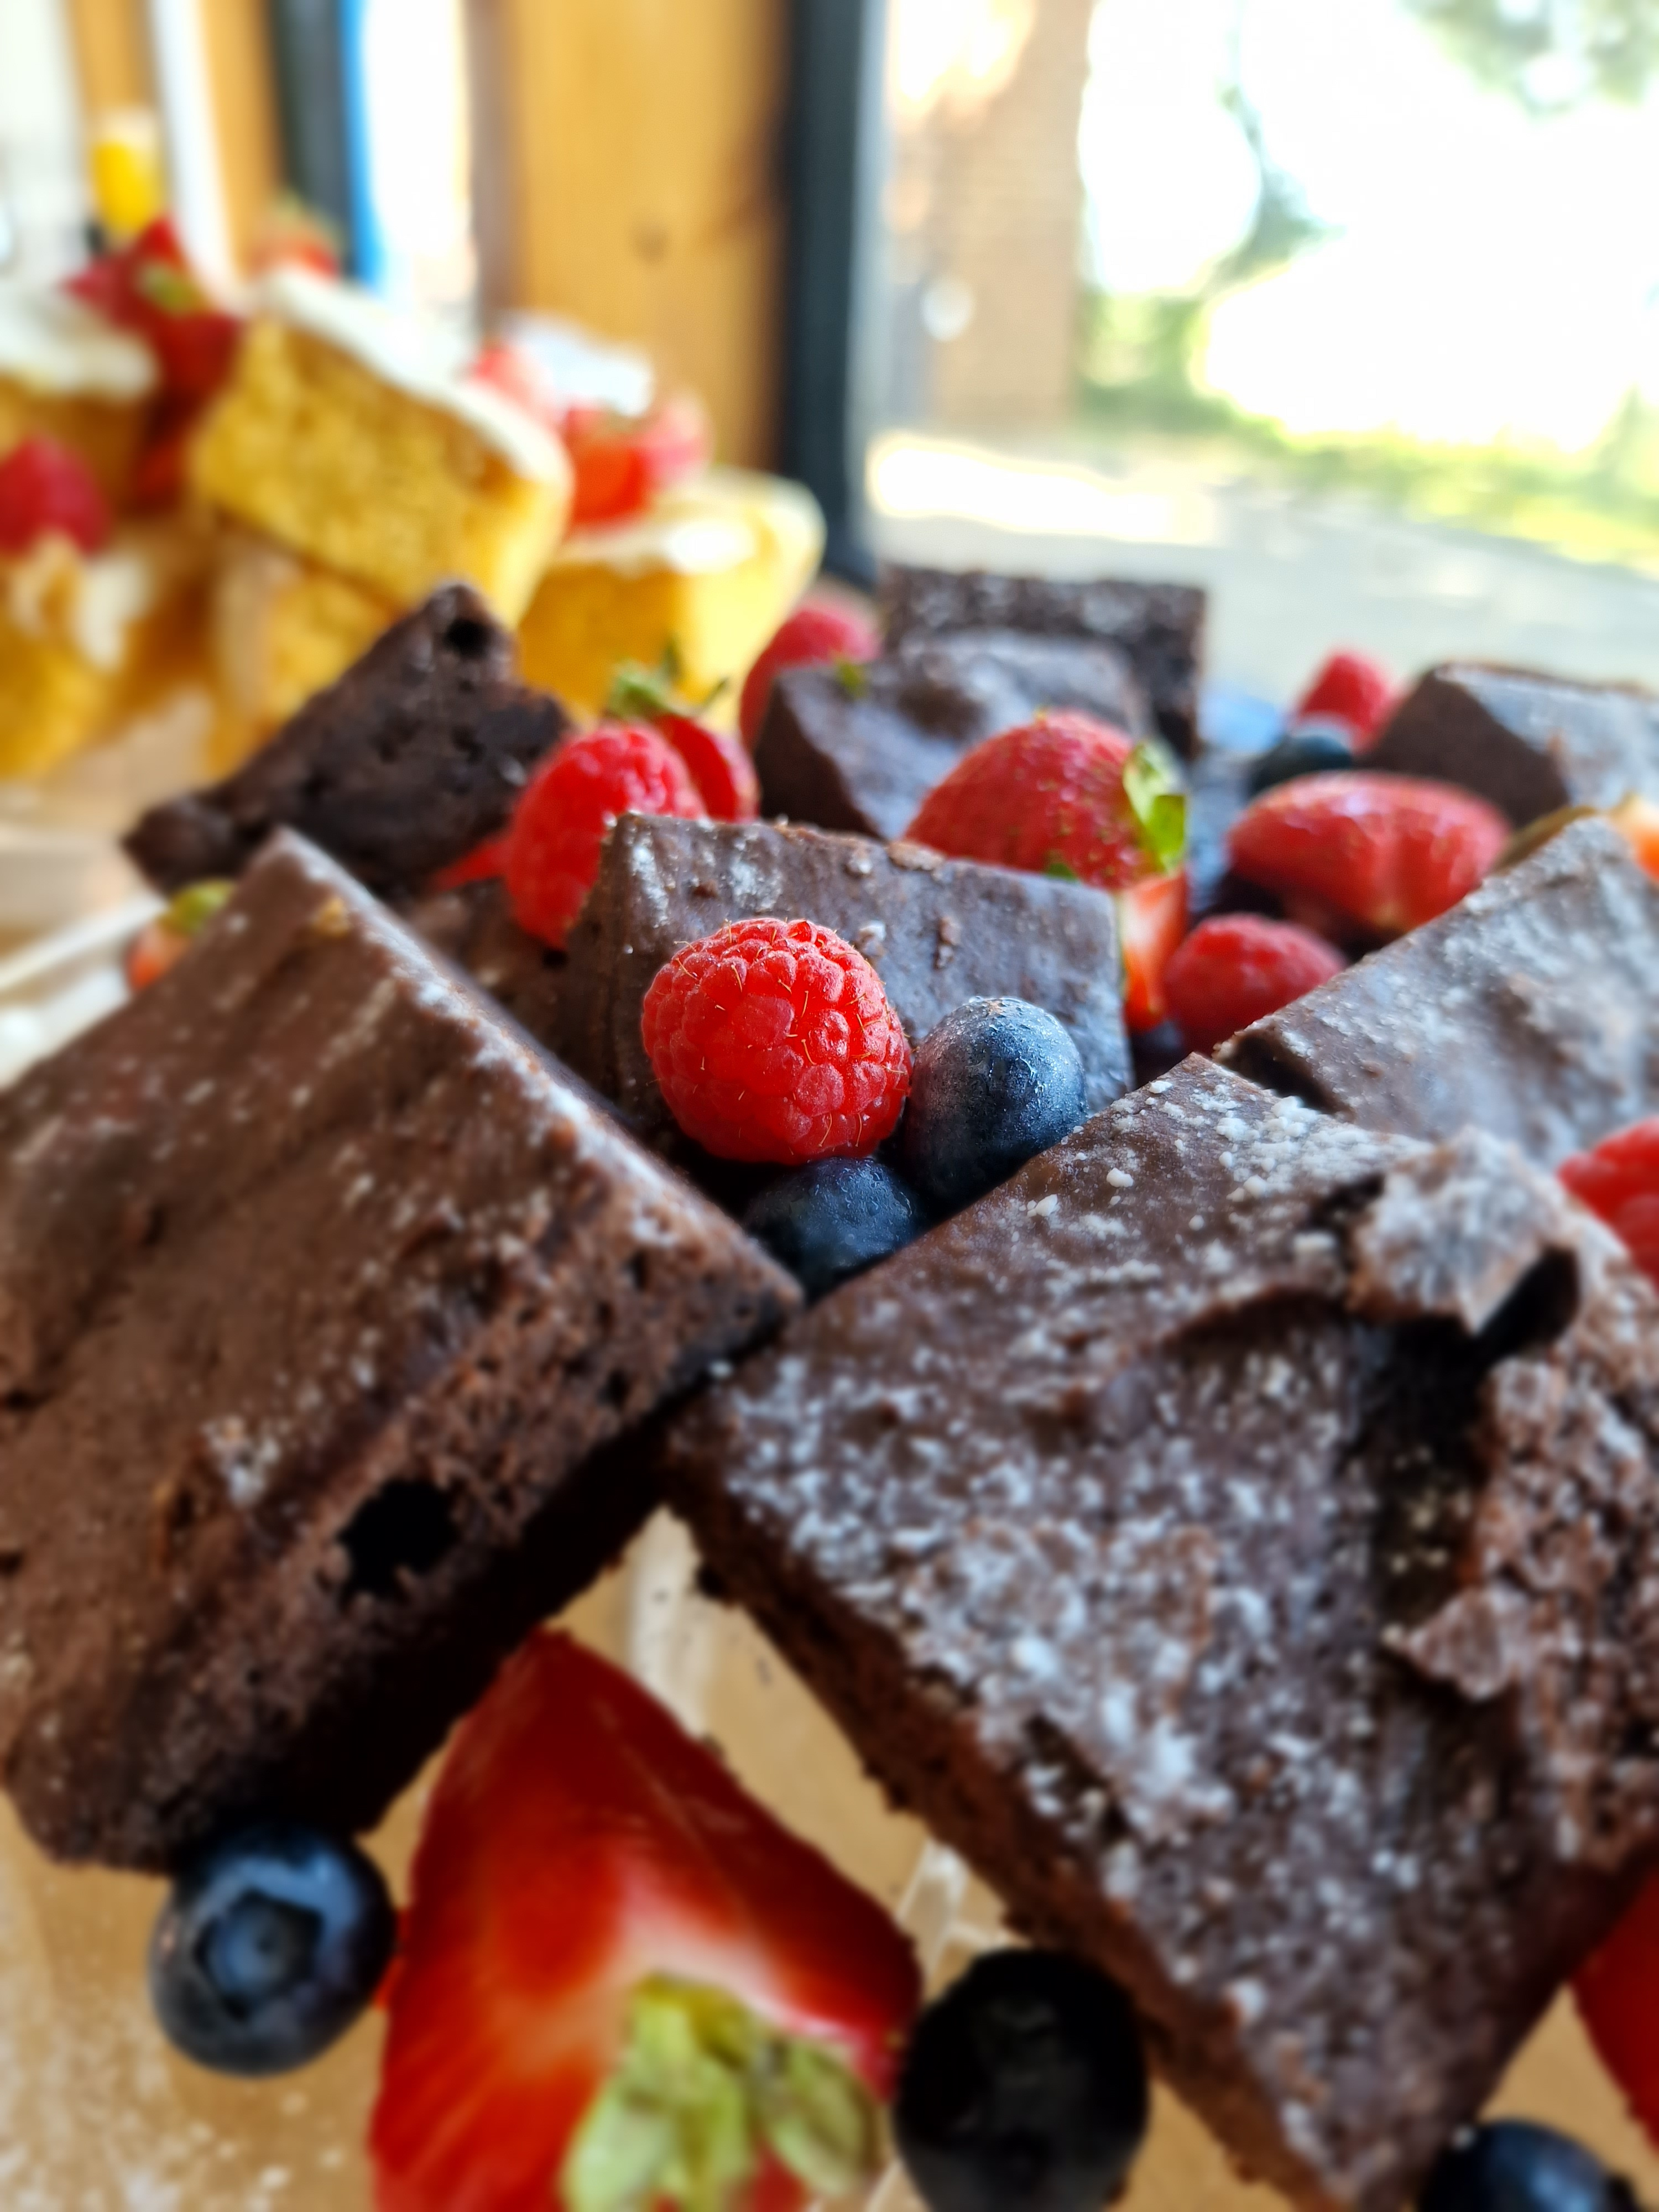
Catering
08:00-09:00 Breakfast
A variety of cereals and milk, toast and a range of preserves
Full cooked breakfast – Eggs, bacon, sausages, beans
Break times (morning and afternoon)
Squash with fresh fruit and cake
12:30-13:15 Lunch
A choice of filled rolls with crisps, fruit, yogurt and a chocolate biscuit
17:30-19:00 Dinner
Sausage and mash/ Chicken Pie with vegetables/ Spaghetti bolognaise or Mac n Cheese
Crumble, Fruit, Waffle and ice-cream, Cheesecake
19:00
Hot chocolate – fruit, cake and biscuits or Fire pit and Marshmallows
All meals and cakes are home-made and drinks are available all day.
Remember your packed lunch on the first day!
We are a nut free site and cater for all special dietary requirements.

Slide 7
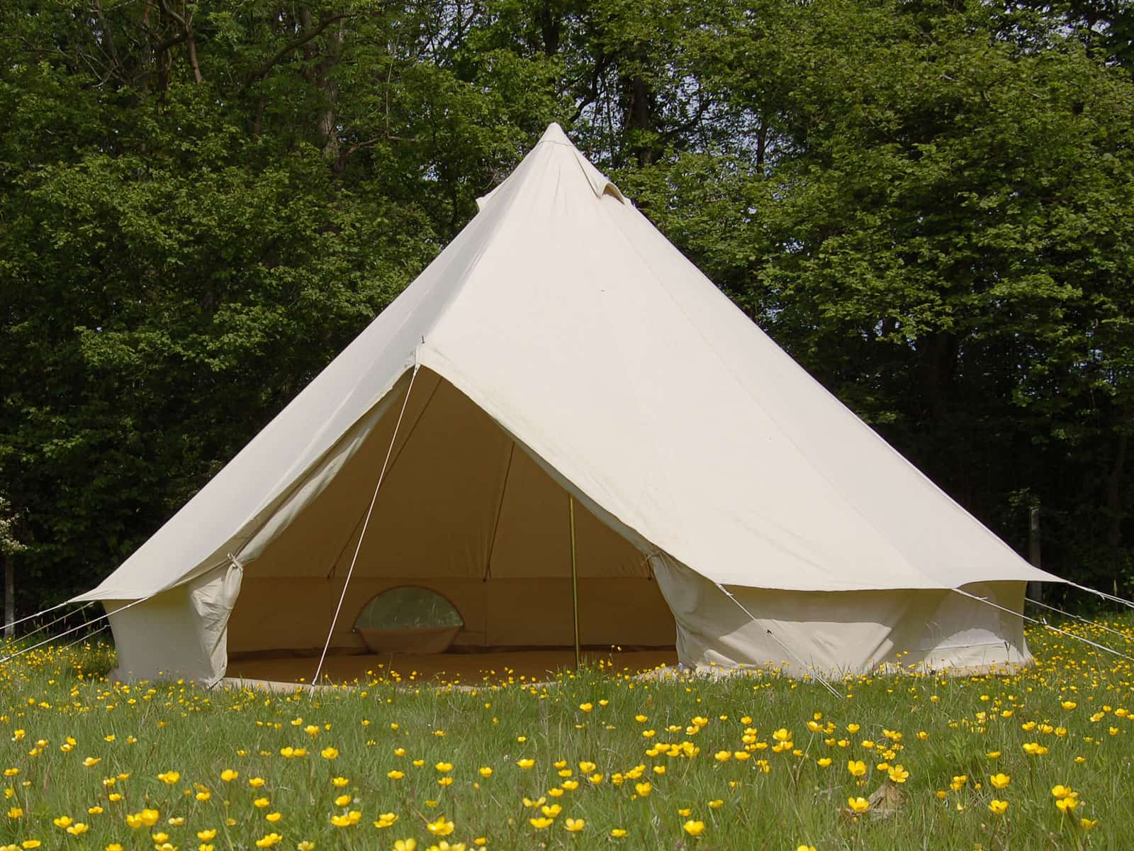
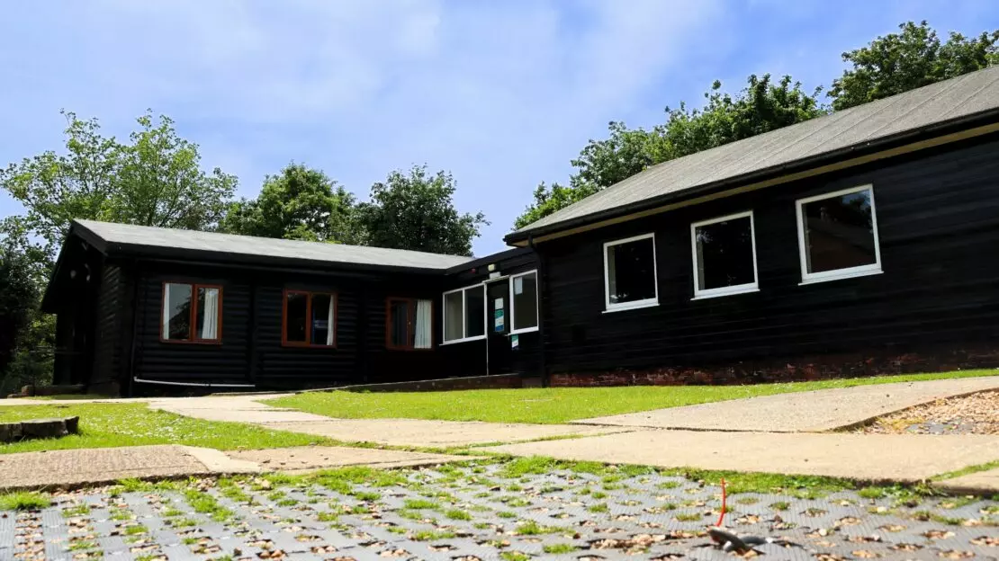
SLEEPING
Some children will sleep in bell tents – these sleep 6-8 children
Some children will sleep in the Log Cabin where rooms range from 4 -11 beds.
Everyone needs a SLEEPING BAG and a PILLOW
If you are in the tents, you will also need a ROLL MAT
Apart from the bedding, EVERYTHING must fit in ONE BAG!

Slide 8
CONSENT Forms
Schools are required to gain consent from parents and carers to participate in our adventurous activities.
This is a statutory requirement.
Schools then give consent to Cobnor on behalf of parents.

Slide 9
Your Commitment
When you agree to the trip on Google Docs, you agree to the terms of the contract with the school. Please speak to Miss Fernandes or Ms Wayman if you would like any support.
The deadline for responding to this link is Monday 13th October.
Families of children in receipt of the Pupil Premium Grant pay half the cost.
There is a 25% deposit required by 31st October. You can pay the full amount in small instalments. This is through Magic Booking.
The total amount needs to be paid by April 13th 2026.
You agree to abide by the school’s decisions regarding groups and activities whilst children are on the trip.
You agree to abide by all the school rules regarding electronic devices and extra food whilst the children are on the trip.
If you pull your child out of the trip, you will only be entitled to the same reimbursement that the school is offered by CACT.

Slide 10
DATES and Costs
Yr 6
Monday July 6th – Wednesday July 8th 2026
Current Yr 5 proposal
Week beginning Sep 21st 2026 – three days and two nights
£275.00 Ability to pay is NOT a criterion – please speak to Ms Fernandes or Ms Wayman if you would like your child to go on the trip but need financial support for them to do so. Children in receipt of PPG funding pay half (£137.50)

Slide 11







FAQ’s
What qualifications do Cobnor staff have?
All staff are first aid trained, DBS checked and have specialist experience and national governing body qualifications. Most importantly, they are energetic and inspire a love for the outdoors and marine environment.
How many members of staff will be on camp with the children?
Our staffing for activities are based on ratios of 1:12 for land-based activities, 1:8 for paddling and 1:6 for sailing.
What happens if it rains?
We provide wetsuits for water-based activities, but we recommend you bring waterproofs. Our activities go ahead in most weathers. You will be outside and will get muddy. Bring old clothes and shoes.

Slide 12
FAQ’s
Can pupils bring their phone?
No electrical devices are allowed.
Due to the remote location, WiFi is not reliable.
What is the schedule?
The day starts with breakfast at 8am.
Activities run from 9.30am till 4.30pm (with morning and afternoon breaks and lunch time).
Supper is served from 5.30pm.
What happens in the evenings?
One night will be a campfire and one will be a walk along the estuary where we can go crabbing.

