Slide 1
What have we been up to in Art club this term?
Year 3 and Year 4

Slide 2
Year 3 began the year learning about
Alma Thomas an American artist who was the first female black artist to go to university to do an art degree. She really wanted to promote art throughout the black communities in America during the 1950s, 60s and 70s. She wanted people to feel good about using colour to express themselves.

Slide 3
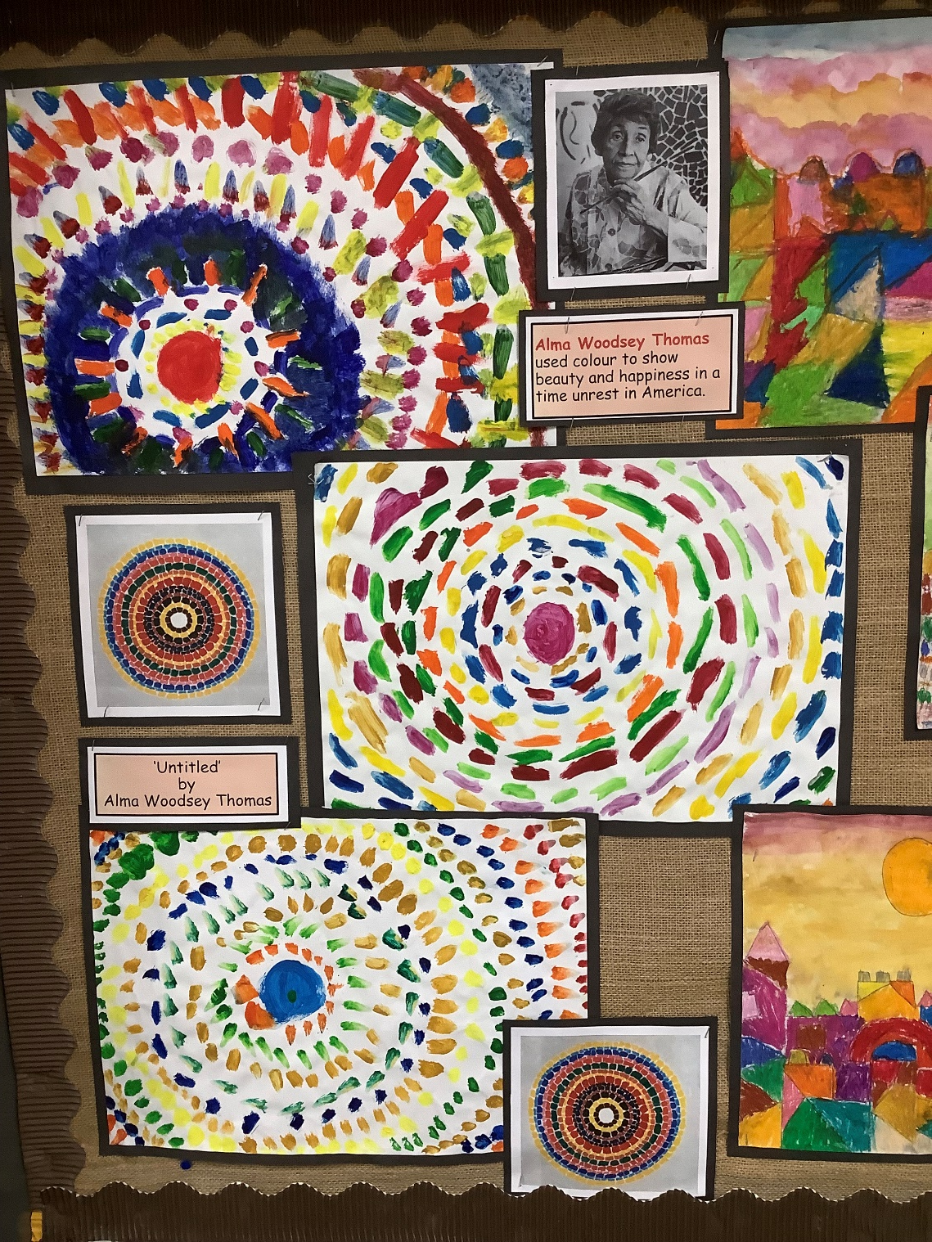
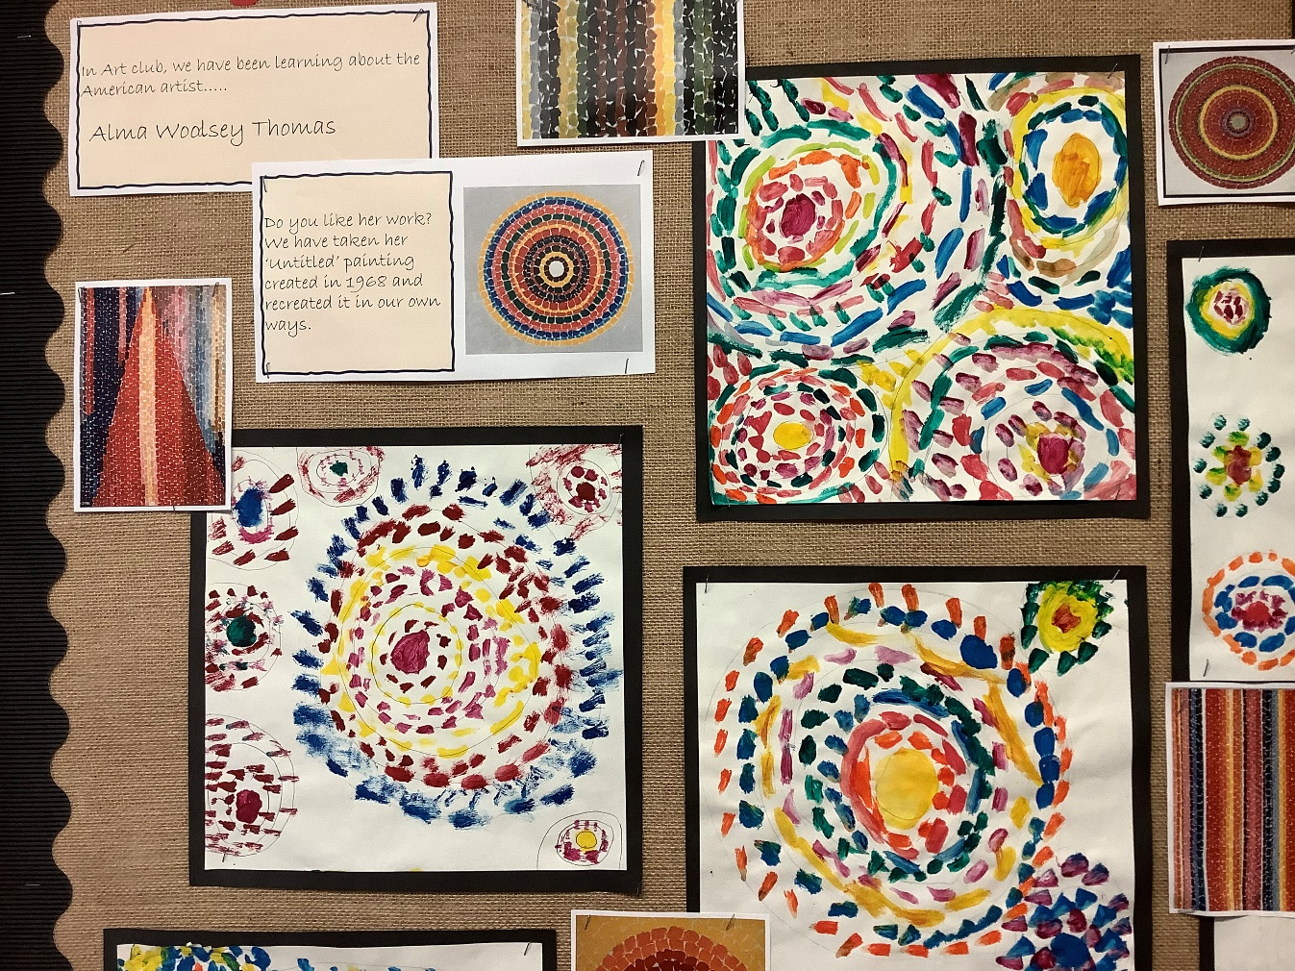

Slide 4
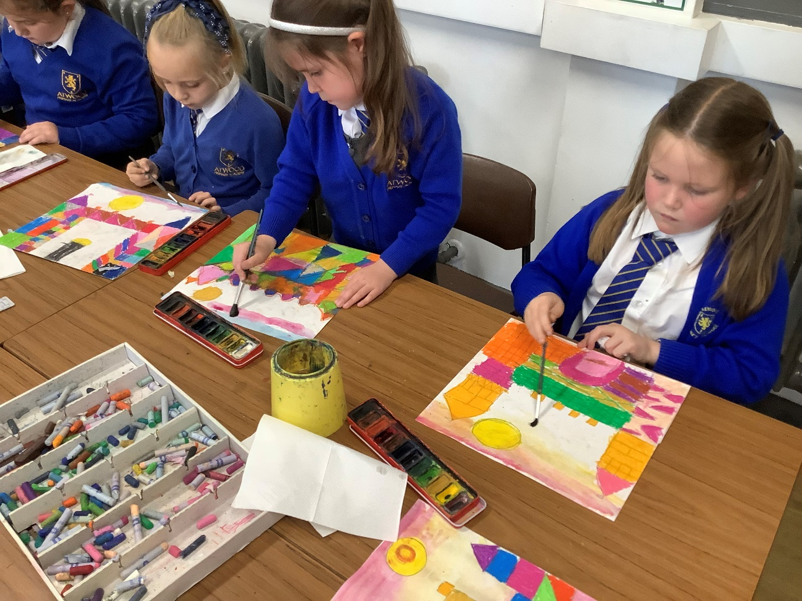
Having begun an exploration of using colour, Year 3 went onto looking at the work of the expressionist artist Paul Klee, in particular his paintings of towns and villages.

Slide 5
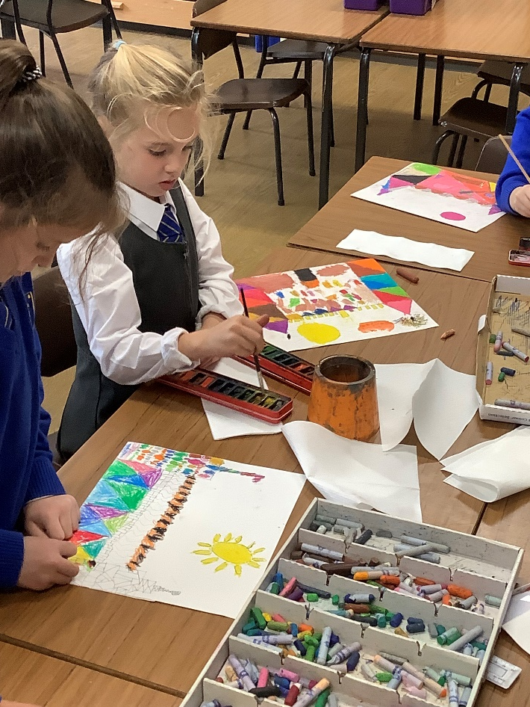
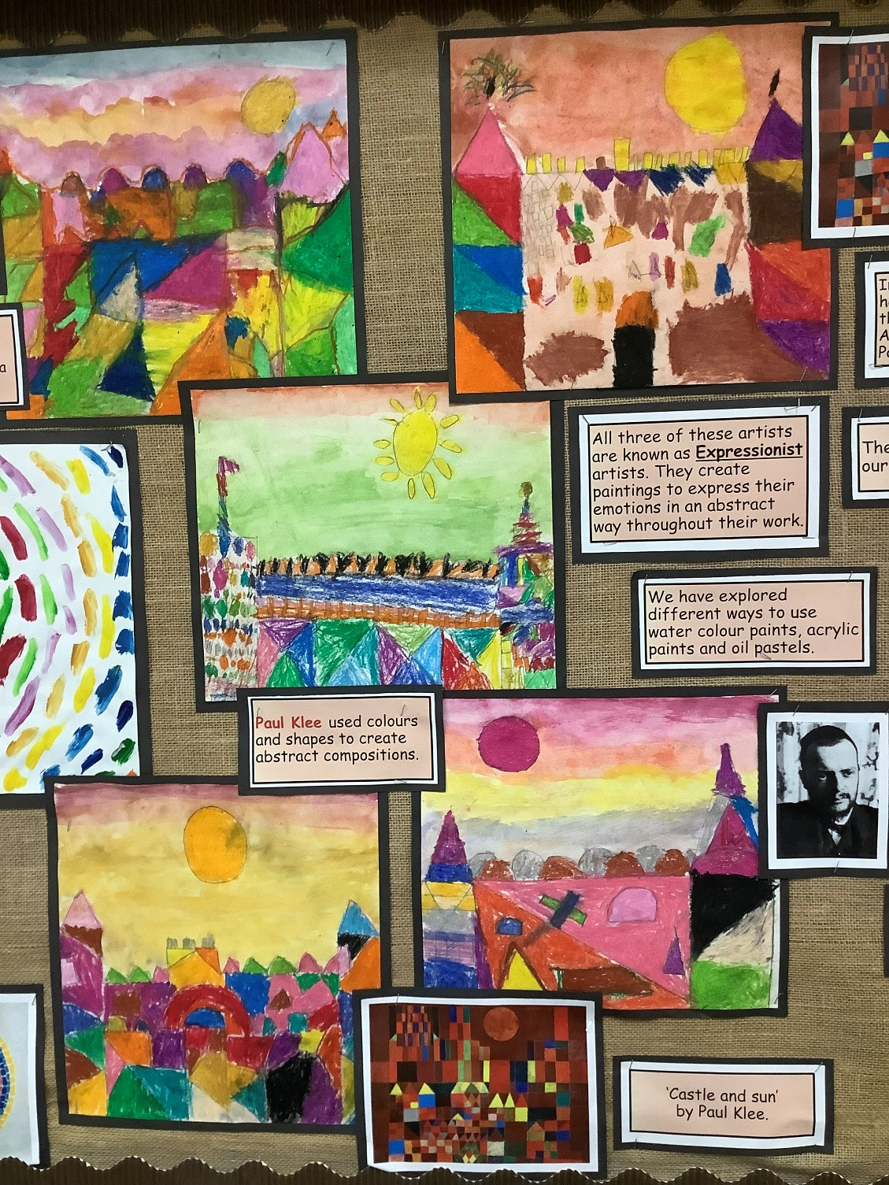
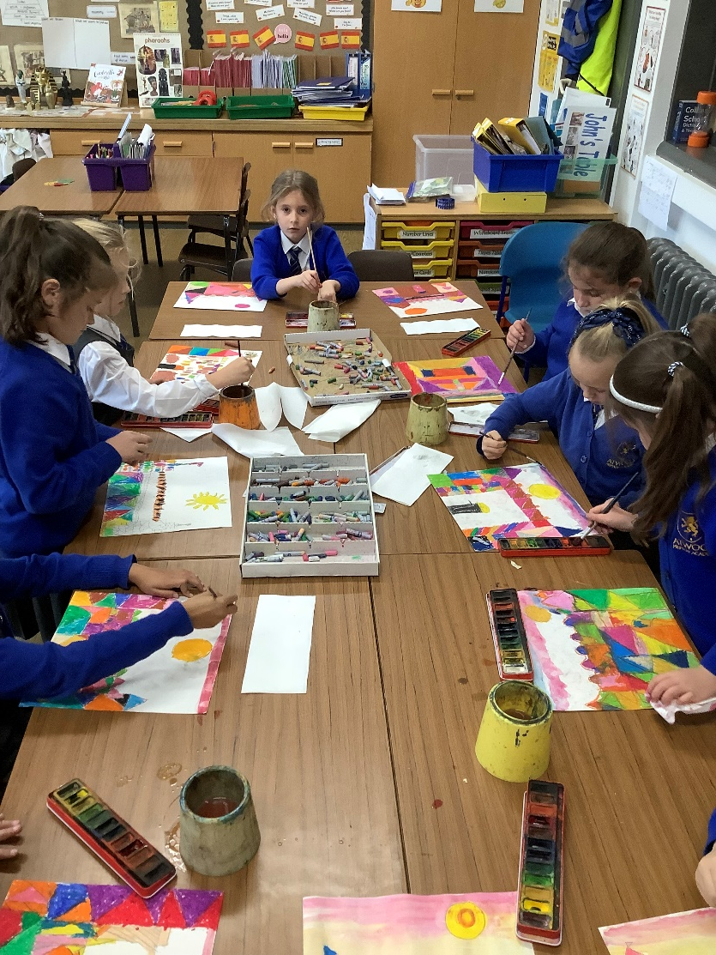

Slide 6
Year 3 continued to explore using colour with a focus on the work of Edvard Munch. We looked at his painting ‘The Scream’ and critiqued how he had used colour to express emotion. We then had fun creating our own interpretations of ‘The Scream’!

Slide 7
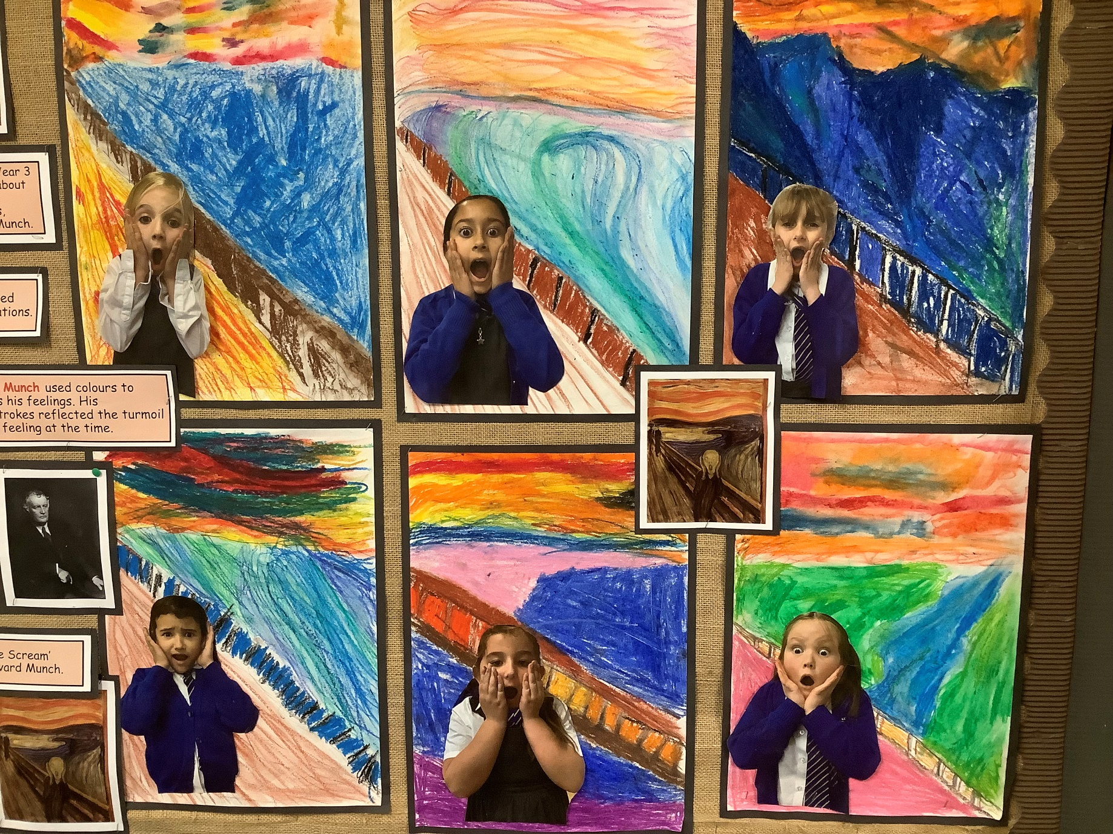

Slide 8
After half term, Year 4 came along to art club.
The first artist we found out about was an Austrian artist called Friedensreich Huntertwasser. He was an artist and an architect who used his dreams and vivid imagination to create abstract art and incredible, fairy tale like, buildings which can be found in Vienna.

Slide 9
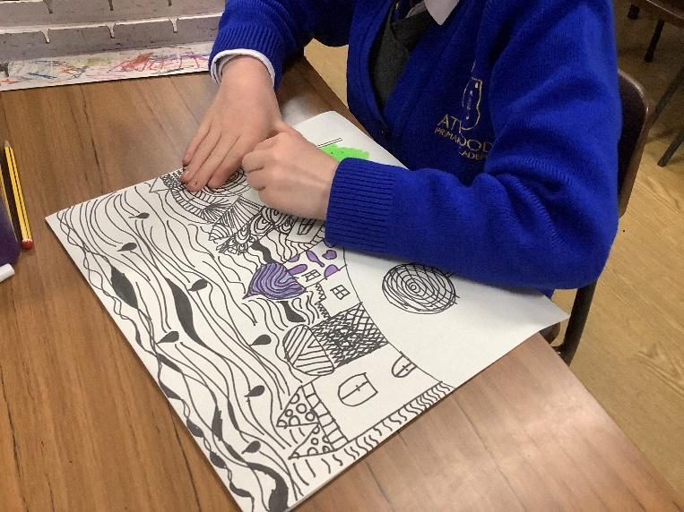
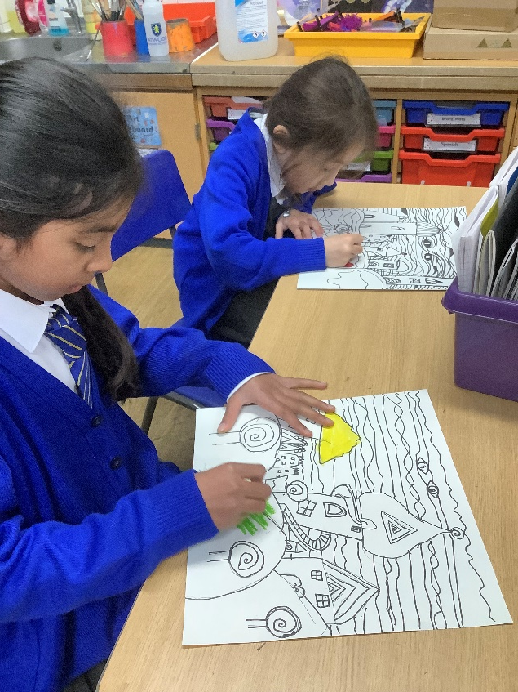
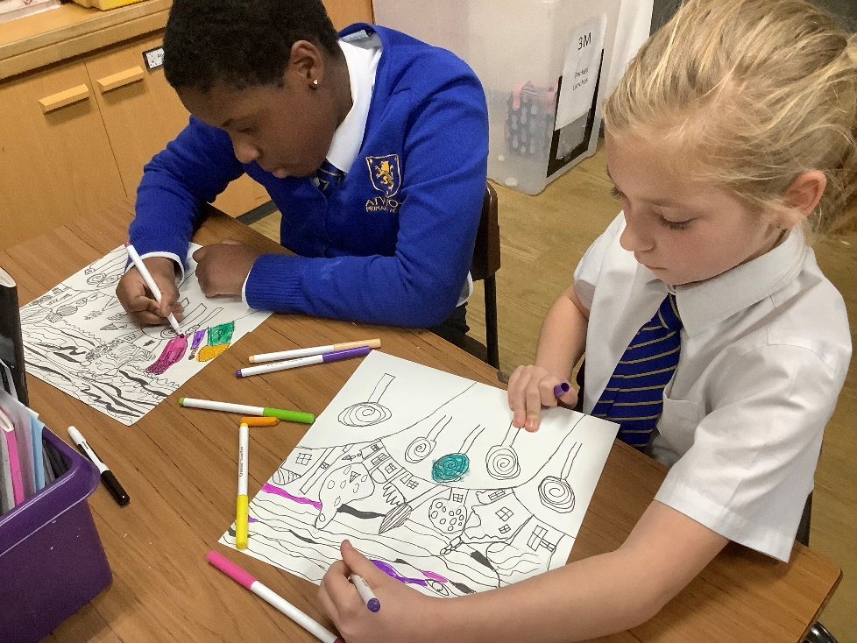
We had a go at creating our own ‘fairy tale’ like village pictures using pastels and pencils in the style of Huntertwasser.

Slide 10
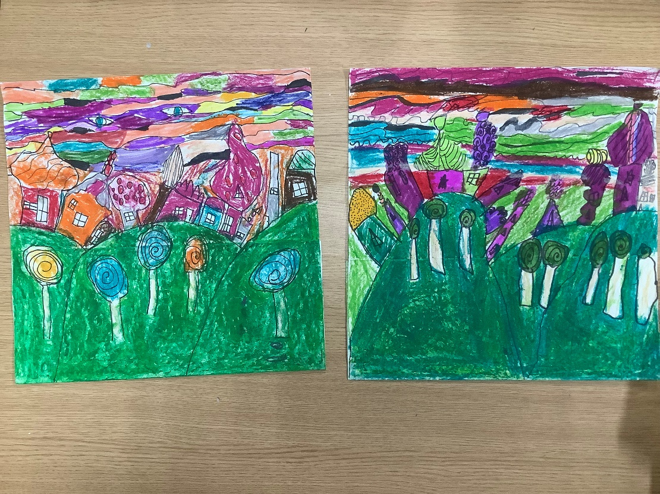
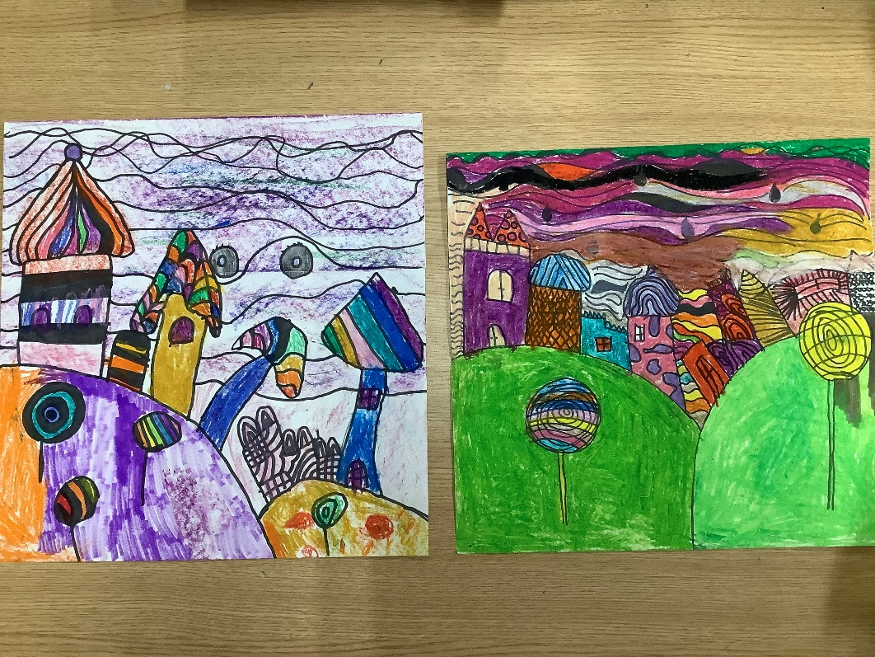
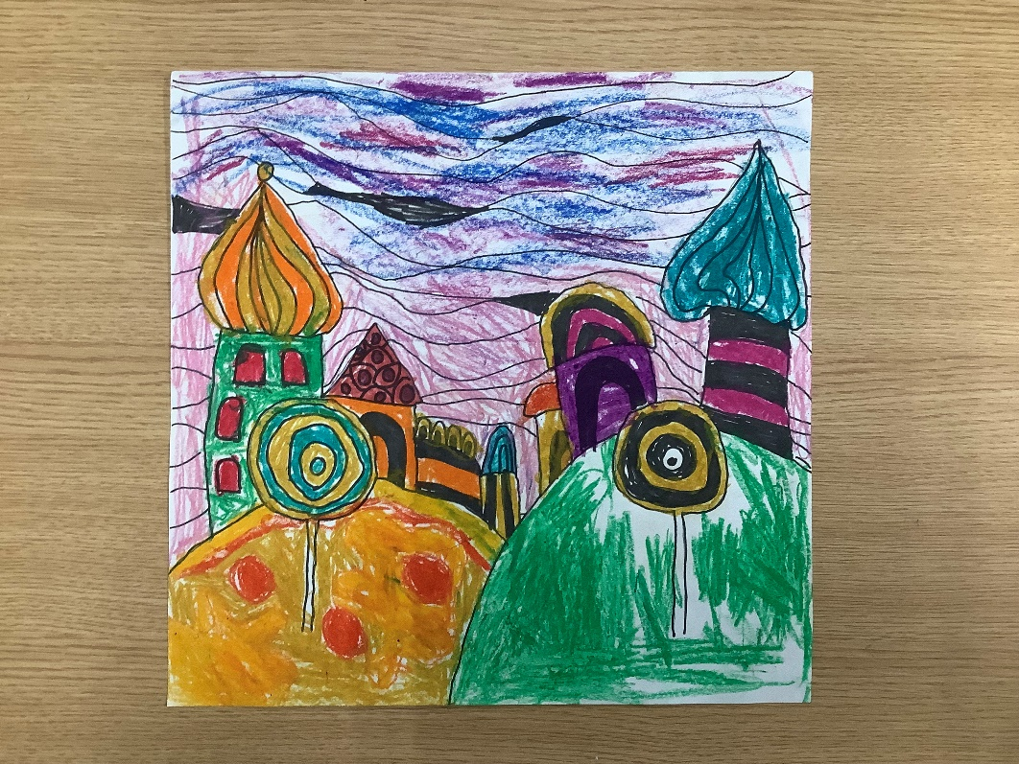

Slide 11
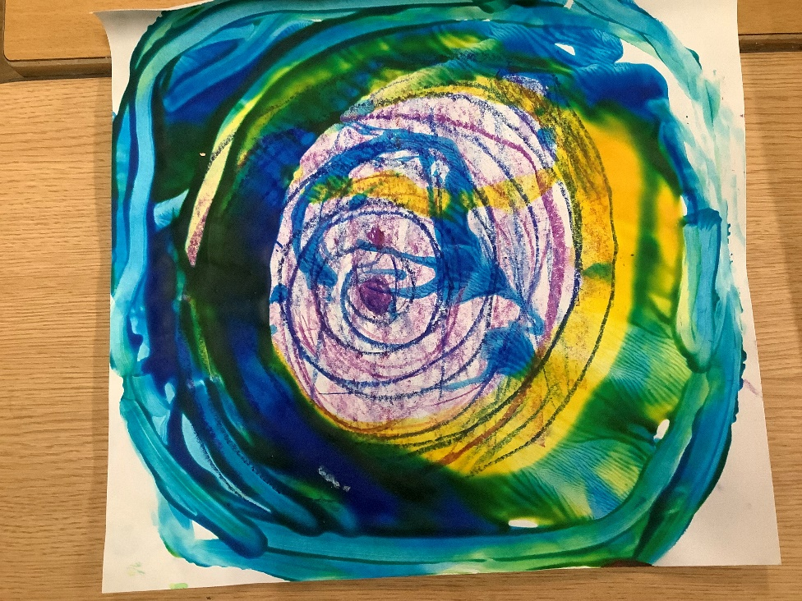
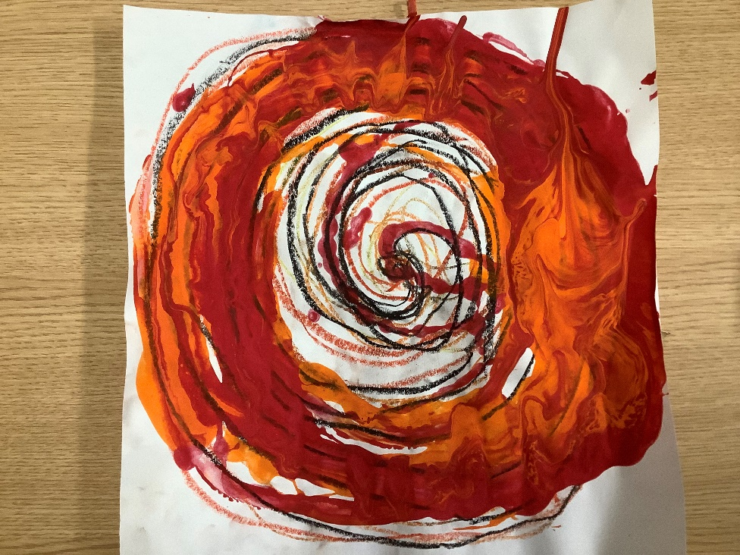
We continued to look at Huntertwasser’s work, focussing on his abstract dream paintings. We began by creating spirals with pastels and then dripped paint in spirals to try and create the ‘vortex’ effect that Huntertwasser created in his paintings.

Slide 12
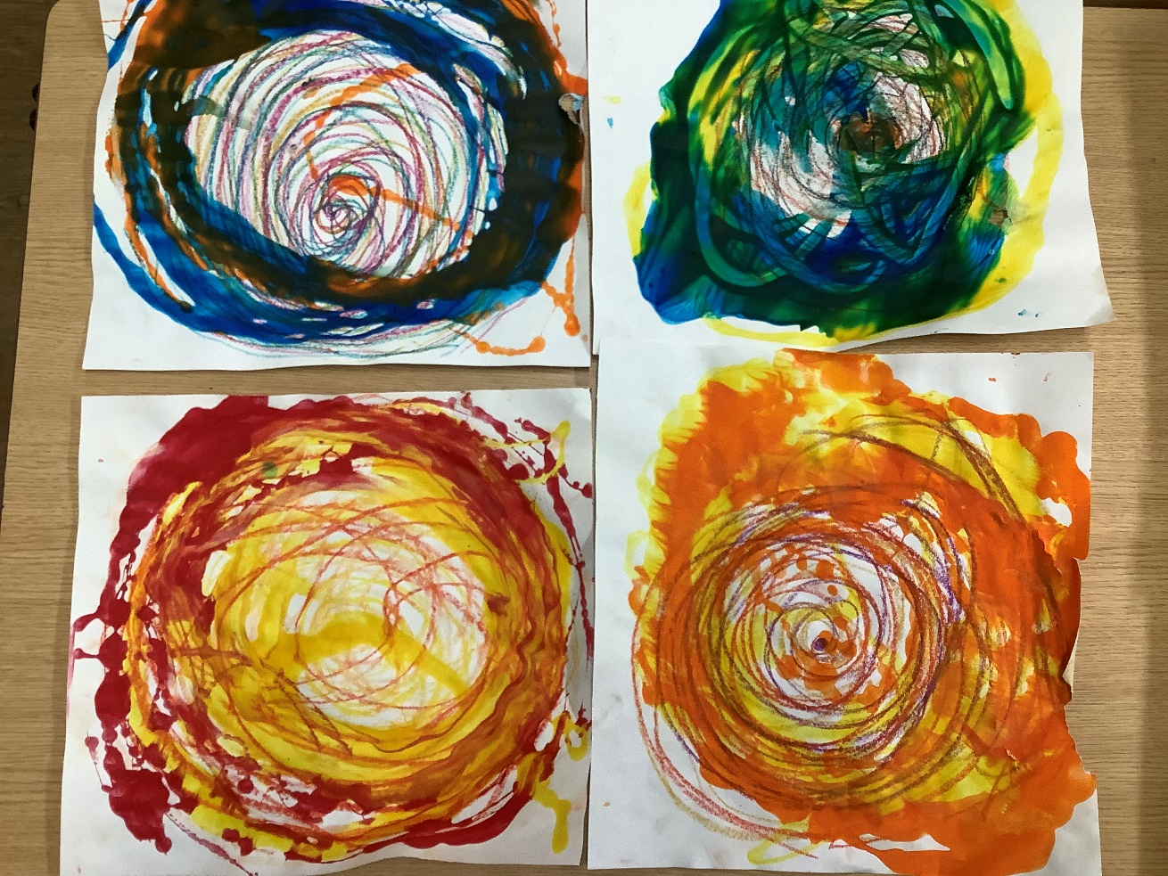
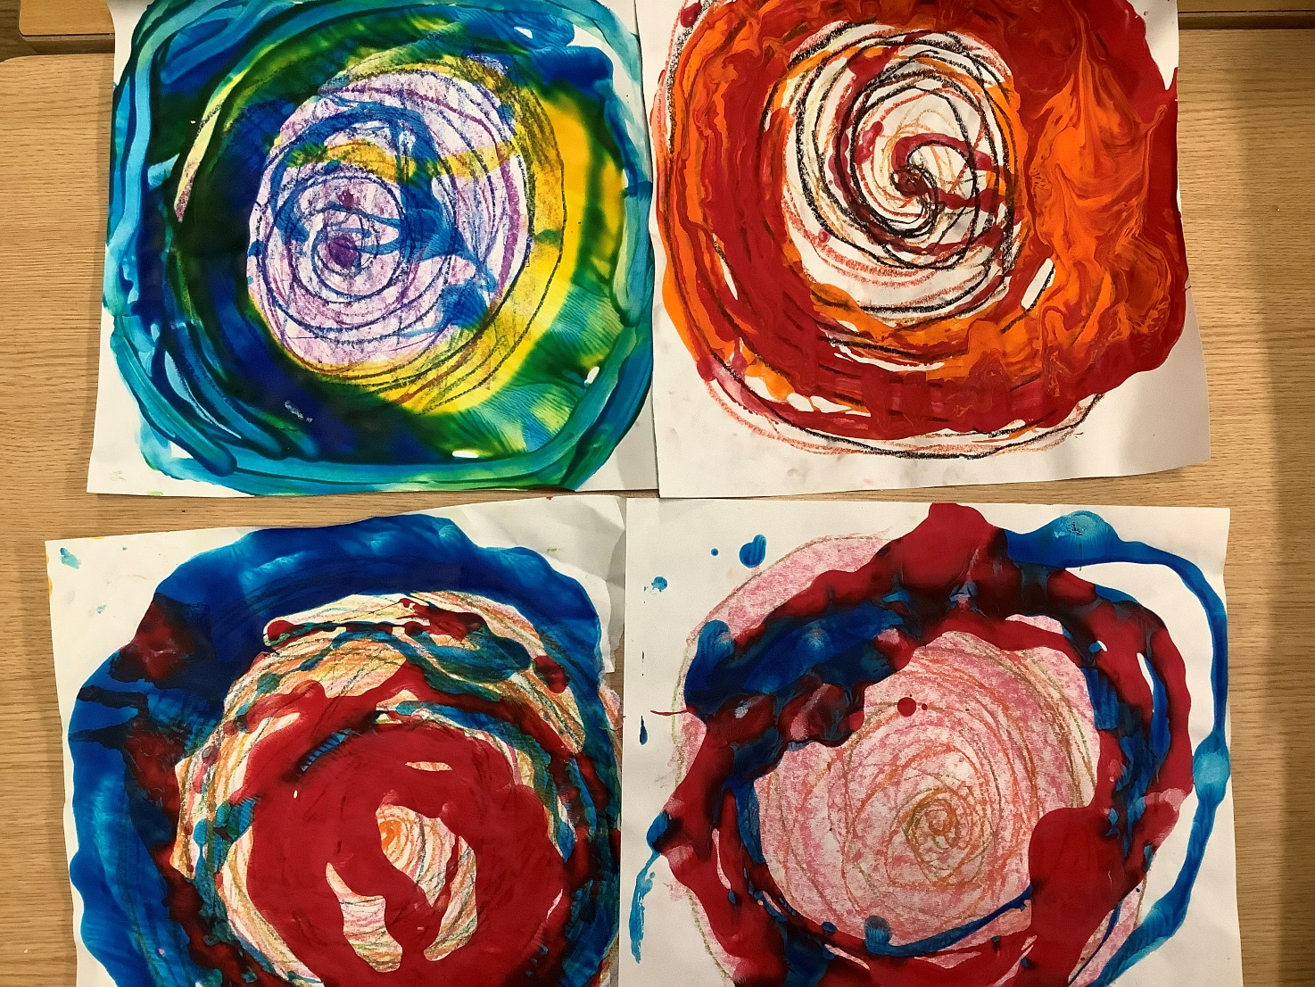

Slide 13
We then spent a session looking at the work of Bridget Riley who created optical illusions with lines and patterns. This wasn’t planned but the children were so taken by one of her pictures (that we accidentally came across) that they wanted to have a go at creating some Op art for themselves!

Slide 14
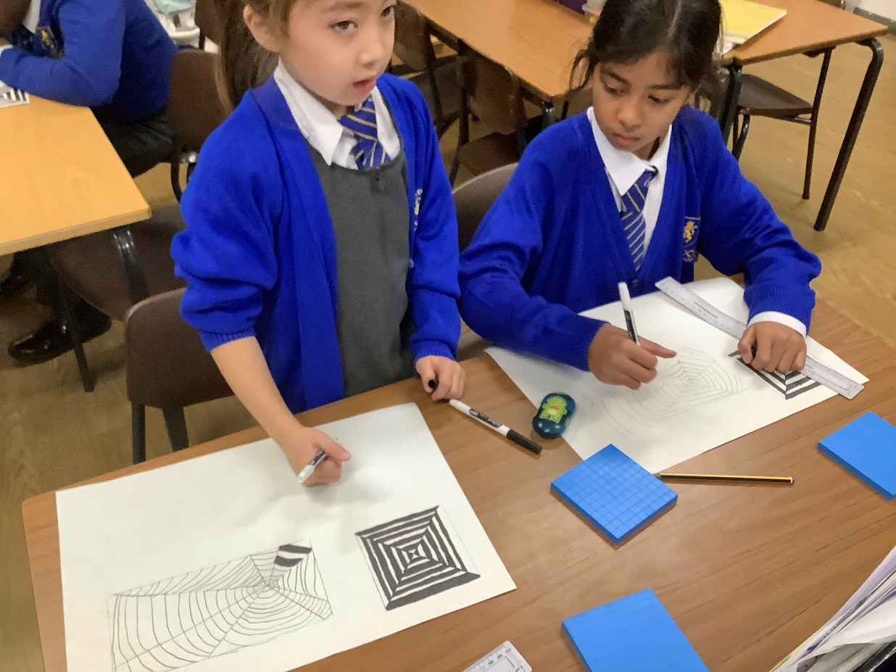
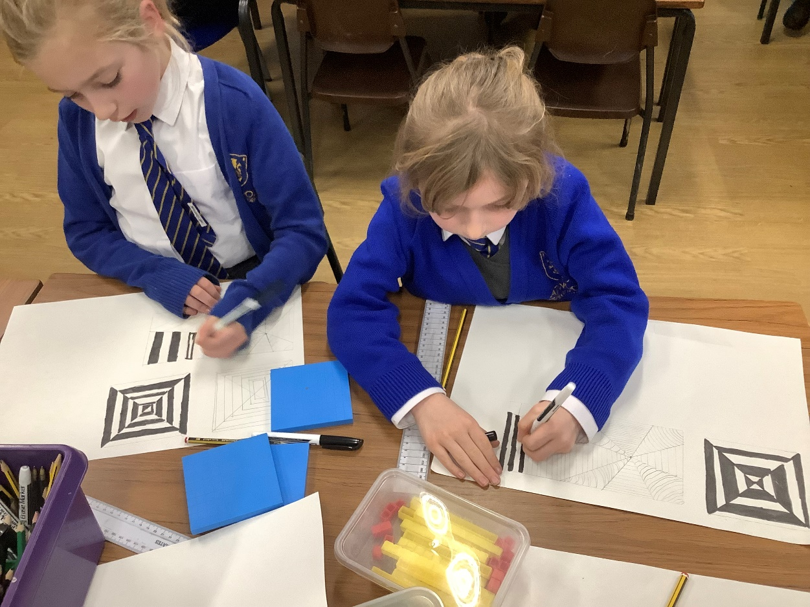

Slide 15
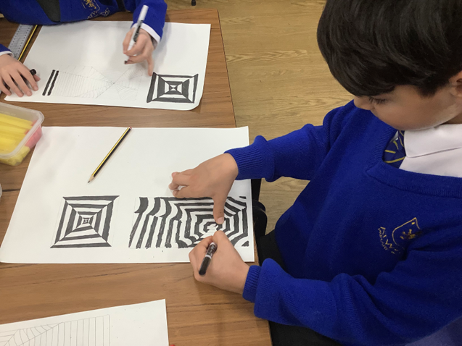
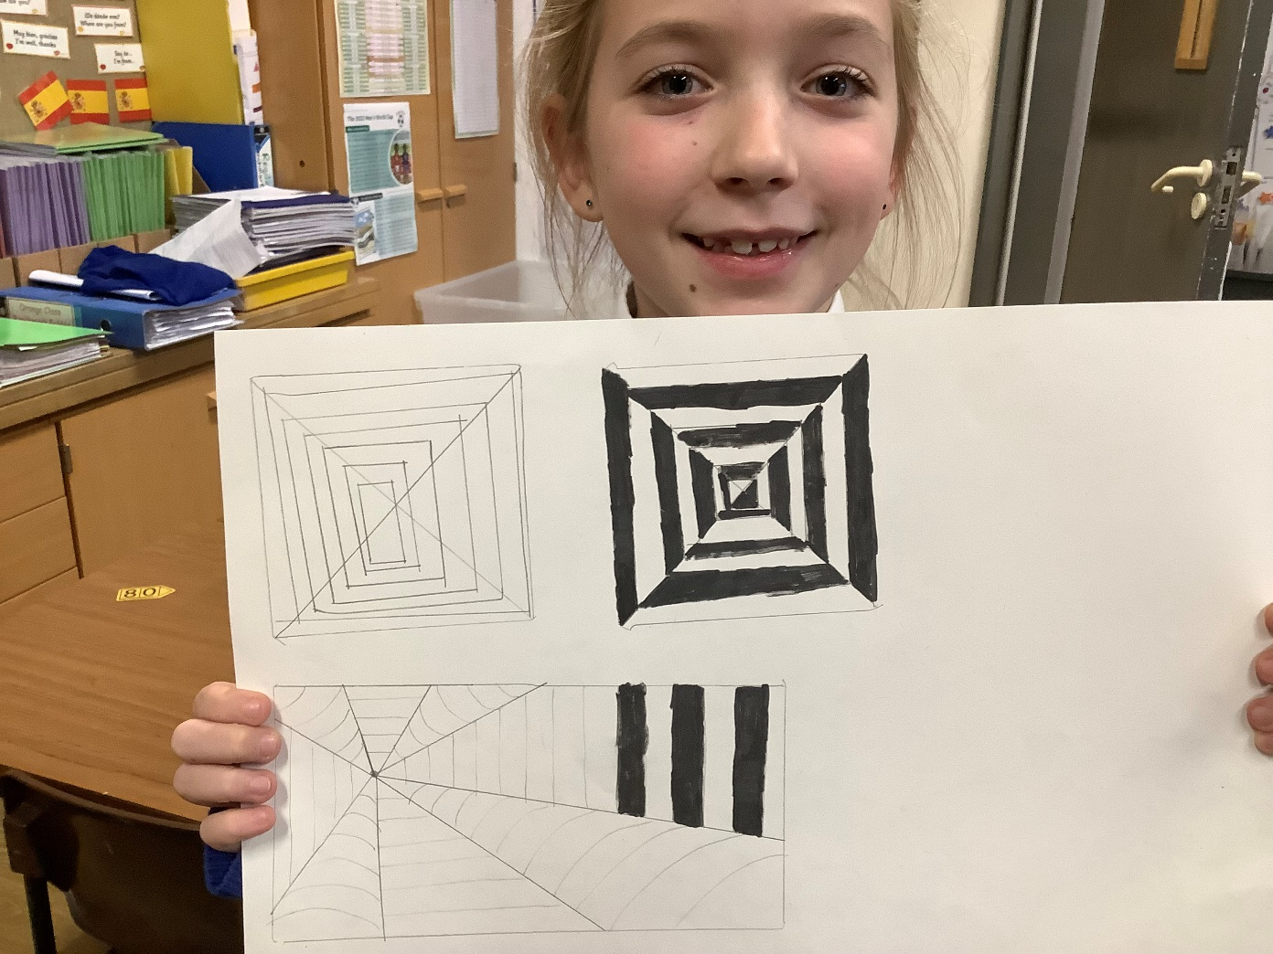
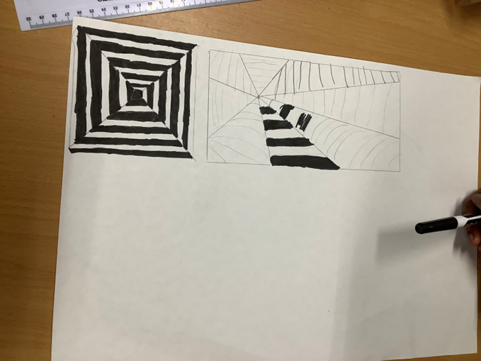

Slide 16
The final artist we learned about was Pablo Picasso. With a focus on his portrait paintings, in particular his painting ‘The Weeping Woman’, we discussed how Picasso had created the composition, using abstract shapes to define the features on the face he painted. We then had a go at creating relief sculptures using layers of card to create faces in a cubist style!

Slide 17
